Slide 1
CATAN AND OTHERS v. MOLDOVA AND RUSSIA
Applications nos. 43370/04, 8252/05 and 18454/06
GC - 19 October 2012
www.promolex.md
www.monitor.md

Slide 2
Individual and general measures
Payment of sum ordered by the Court in the amount of EUR 6000 for each applicant, as well as the payment of the costs and expenditures.
The elimination of all provisions that restrict the use of the Latin alphabet in the functioning of the Romanian language in the transnistrian region (Article 6 of the “Law on languages” of the region, Article 12 of the region’s “Constitution”, Article 200/3 of the region’s “Code of Administrative Offences”, decision of 18 August 1994 on the prohibition of the use of the Latin alphabet in schools);
The annulment of the obligation that educational institutions operating in transnistrian region that use the curriculum approved by the Moldovan Ministry of Education or wish to work in the region on the basis of that curriculum register with the so-called ”Ministry of Education”.
#PromoLEX

Slide 3
Individual and general measures
The removal of any prohibition on the introduction of books and textbooks for study in educational institutions using the Latin script in the transnistrian region.
Repeal provisions of the so-called local authorities of the towns of Ribnita, Bender and Grigoriopol in regard to the eviction of high schools from buildings owned by them.
The restoration of the building for “Evrica” High School, and the building formerly used by the “Stefan cel Mare” High School in Grigoriopol before the evitction, and assigning a building for “Alexandru cel Bun” High School.
www.promolex.md

Slide 4
Non-Execution by Russian Federation
On 15.11.2021 the Russian Federation submited an communication which mentioned that they ”have made significant efforts to find acceptable solutions to the current situation that would not contradict the principle of non-interference in the affairs of other sovereign States”.
This information practically repeated the same text as previously submited communications, except that the Russian Federation considers that ”today the situation in Transnistria is significantly different from what it was at the time the applications were lodged to the European Court”.

Slide 5
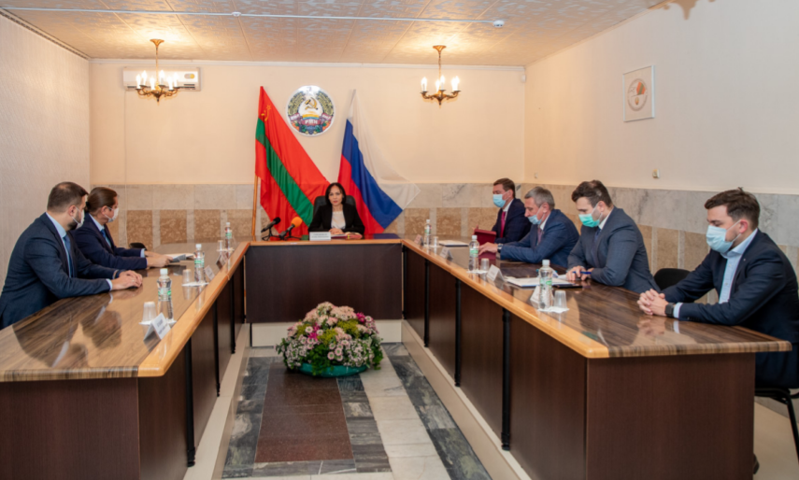
Political support of Russian Federation
On 16.06.2021, the State Duma of the Russian Federation adopted a Declaration requesting the President and the Russian Government not to allow the application of the joint Moldovan-Ukrainian customs control to the Transnistrian border segment from July 1.
H.E. Ambassador Vasnețov of Russian Federation, regularly participates in different public events organised by transnistrian administration.
A lot of deputies from State Duma participated on different occassions in the events organised by ”transnistrian officials”.
In the region, 59223 people participated in the RF Duma election in 2021. For this election 27 polling stations were opened in the transnistrian region, without the permission of the Republic of Moldova.
Notes:
• În perioada 25 iunie – 1 iulie 2020, a avut loc Referendumul pentru modificarea Constituției Federației Ruse.
La 22 octombrie 2020, în cadrul unui mese rotunde care s-a desfășurat în regim online, au avut loc discuții între deputații Dumei Federației Ruse și oficiali din cadrul administrației de facto de la Tiraspol. Discuțiile s-au rezumat la ajutorul financiar acordat de către Rusia anual, la modificarea legislației locale potrivit modelului rus și la oportunitățile de colaborare pe viitor

Slide 6
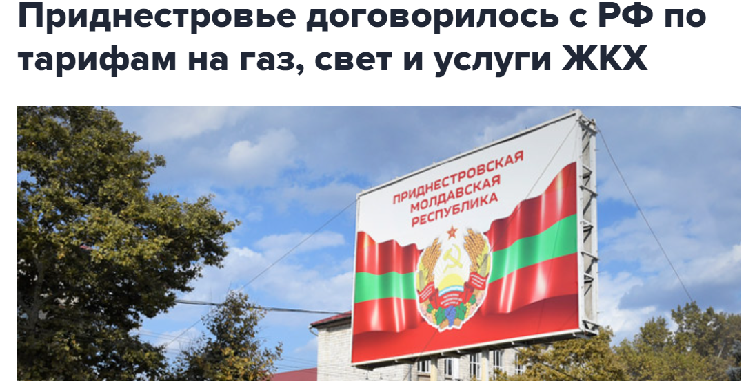
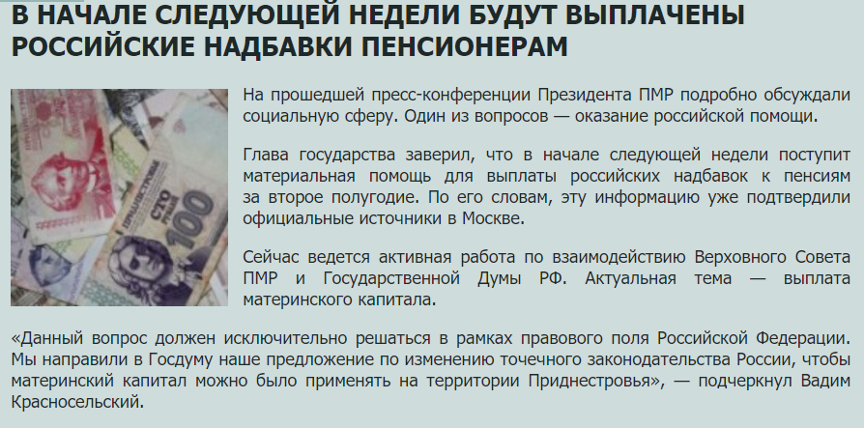
Economical support of Russian Federation
Russia has provided humanitarian aid as a supplement to pensions since 26 December 2007.
In 2020 Tiraspol received ”humanitarian aid” to pensions for more than 146000 pensioners, or more than 2,5 mil. euro.
After the gas crisis, Russia keeps the same price for gas for ”MRT”, but at the same time raises the price for the rest of Moldova up to two and half times. For example, the price in the transnistrian region costs about 1 lei or 0.05 Euro, but for rest of Moldova costs 11 lei or 0.5 Euro.
www.promolex.md

Slide 7
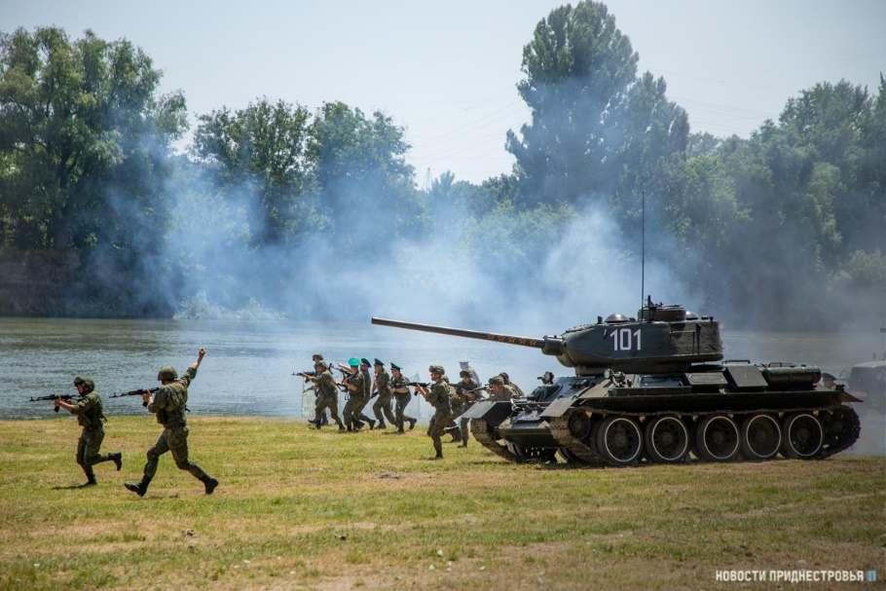
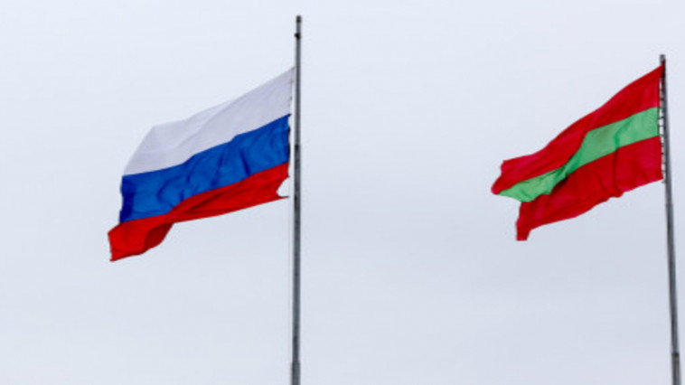
Military support of Russian Federation
Joint drills of military units of Russian Federation and secessionist paramilitary groups
Russian Operative Group has so much been integrated into the society from this territory that it creates jobs for the inhabitants of the transnistrian region, it also offers ”lessons on peace” and patriotism for the young generation.
During 2021, ROG realized at least 450 actions, from which 300 are social or sportive actions.
www.promolex.md

Slide 8
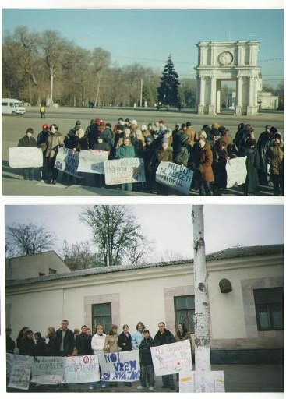
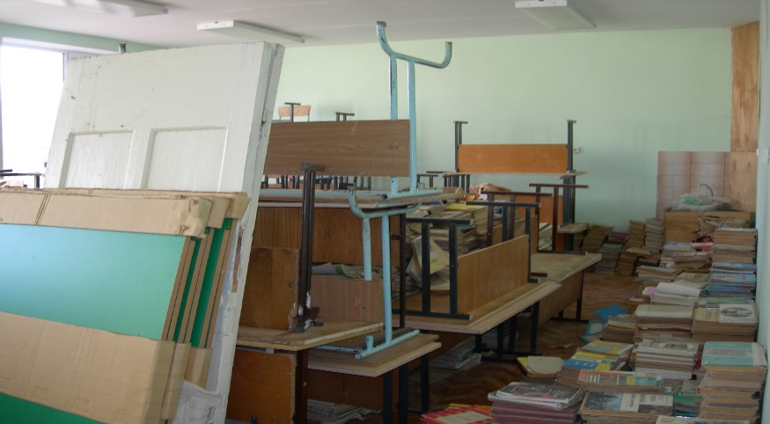
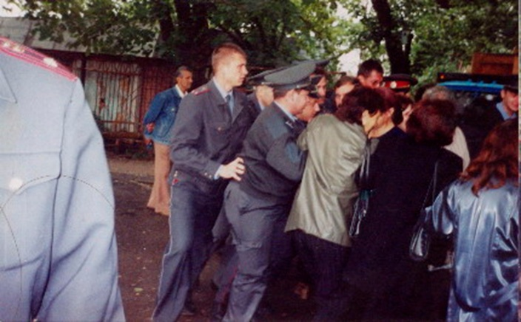
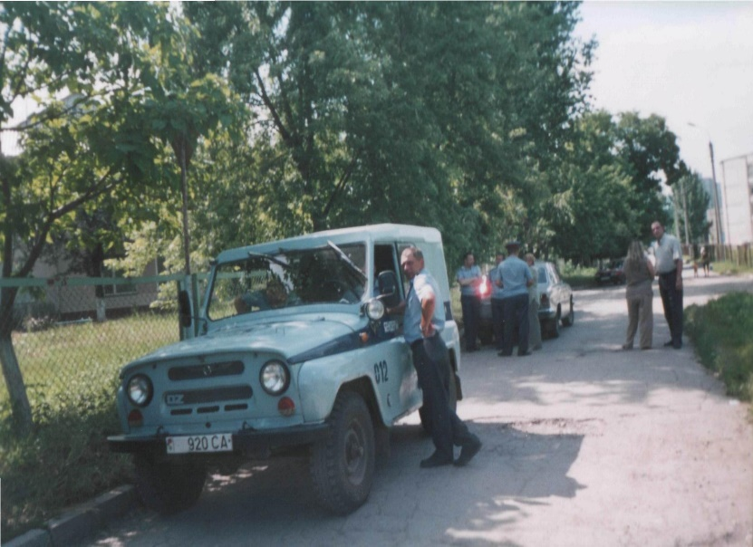
The problem of education in time

Slide 9
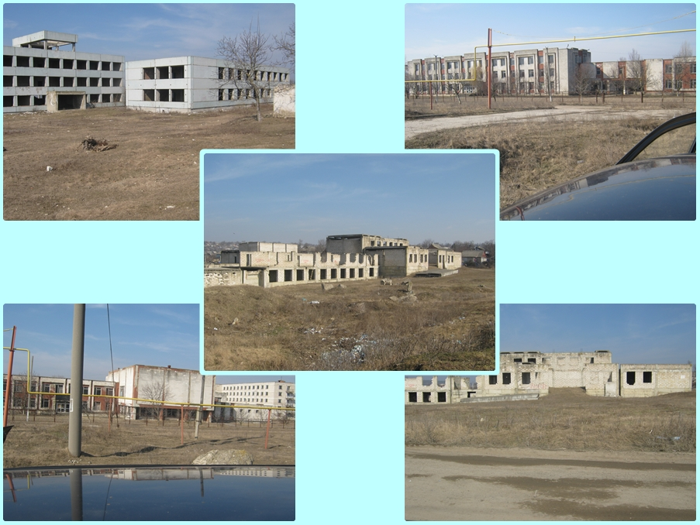
The problem of buildings
Neither of the edifices of the schools situated on the left bank of the Dniester River are adapted to the educational process according to the standards of the Ministry of Education (except for Roghi).
All the premises seized from educational institutions in Bender, Grigoriopol and Rîbniţa are currently subordinated to local public administrations and are not used by any public institution in the region
#PromoLEX

Slide 10
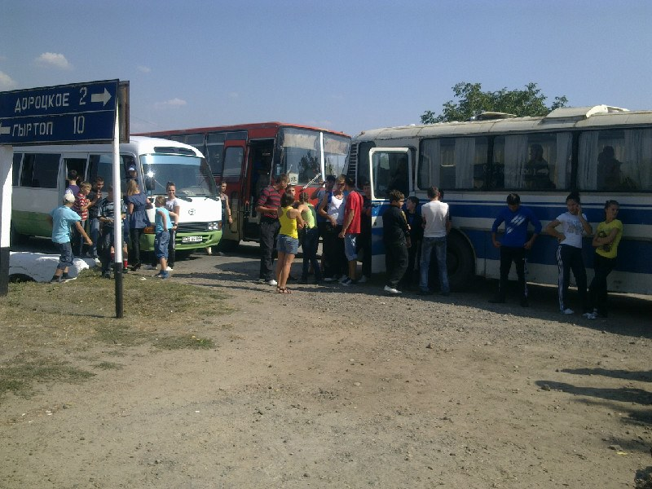
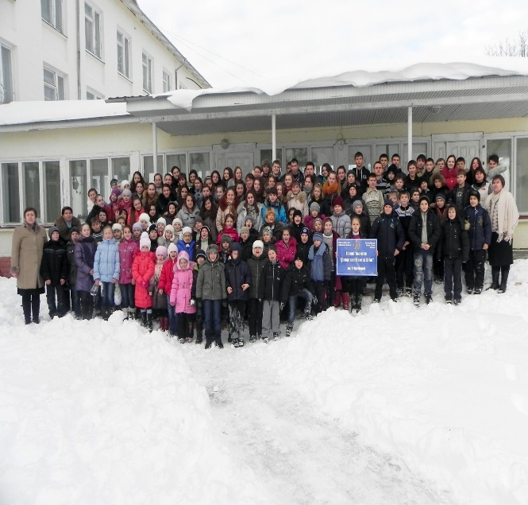
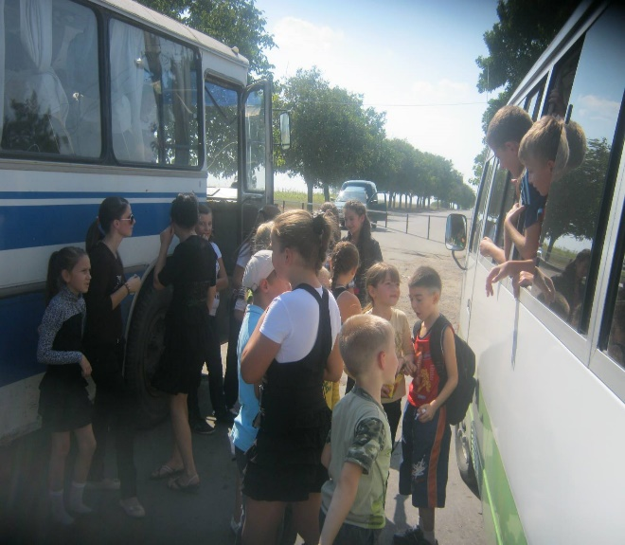
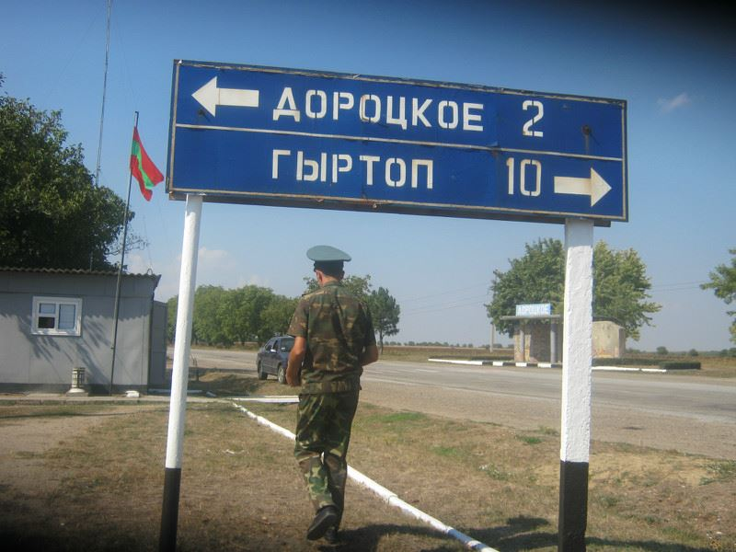
The problem of pupils
Most of the students suffer from psychological trauma (PTSD).
The children are forced to cross tens of kilometers in order to attend the schools.
The health condition of children is posed at threat because of the lack of healthy food, physical exercise.
Complete lack of the information in the mother tongue.
The children studying in these schools are victims of discrimination and intimidation (including recruiting into the Transnistrian army).
www.promolex.md

Slide 11
Way to education

Slide 12
Intimidation and discrimination
The local television and mass media foster hatred and discrimination against Moldovan and Ukrainian ethnicities.
Unannounced visits of various control bodies to educational institutions for intimidation purposes.
Threats on behalf of Security and Military Structures addressed to School headmasters.
Military recording and enrollment of young people in paramilitary structures.

Slide 13
Recommendations
We call the Committee of Ministers to insist that Russian authorities have to:
Pay the compensation due to all applicants;
Present a concrete action plan including the general measures indicated in the ‘General Measures’ section above;
We call the Committee of Ministers to debate the case at every CM/DH meeting;
To publish the letter from the Secretary General of CE to Mr. Lavrov, and his answer;
We also call on Committee of Ministers to continue all the efort for the execution of this judgement, including all the preliminary actions before applying infringement proceedings art. 46.4 of Convention.
www.promolex.md

Slide 14
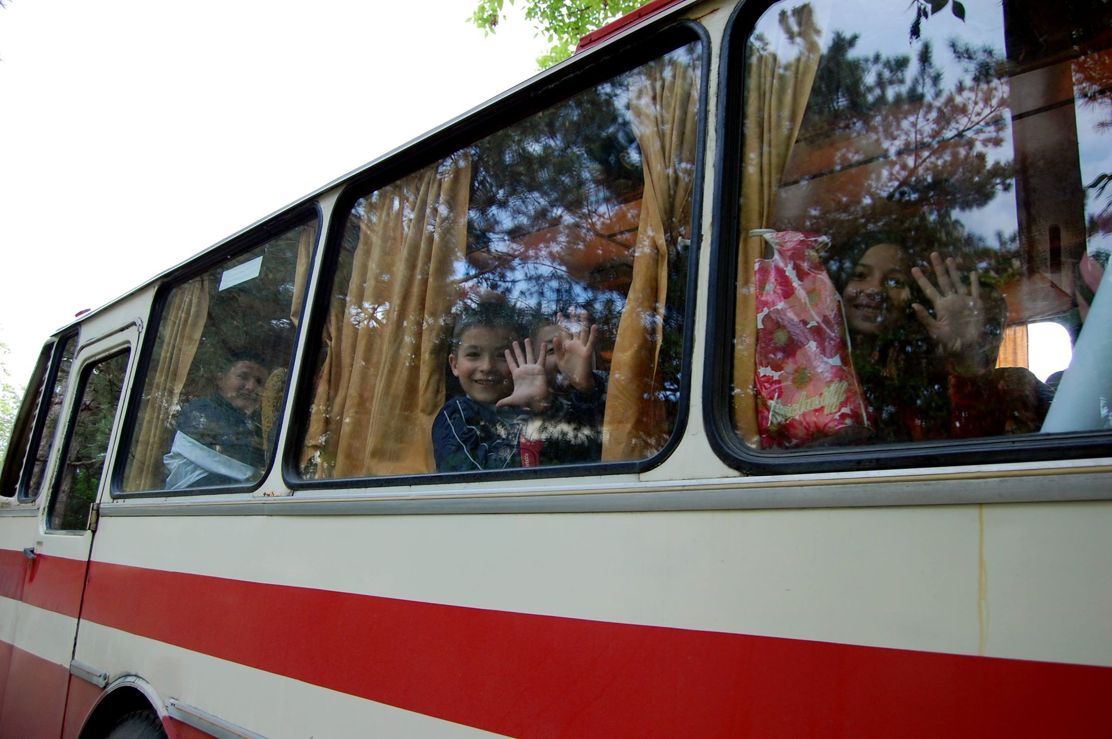
Q&A
www.promolex.md

