Slide 1
Presentation On the Supervision of the Execution of the Judgement
In the Case of Selahattin Demirtaş v. Türkiye (no. 2) [GC]
(App. No: 14305/17)
Legal Representative of the applicant Mr Selahattin Demirtaş
Att. Benan Molu
16 September 2022, Strasbourg

Slide 2
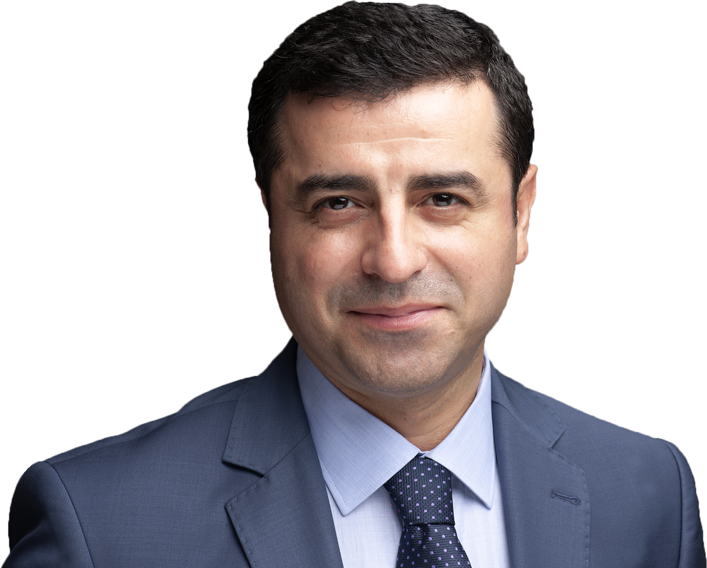
Mr Selahattin Demirtaş, who was at the time one of the co-chairs of and a member of parliament for the Peoples’ Democratic Party (HDP) was placed in pre-trial detention on 4 November 2016. It is alleged that he, through his speeches and statements had incited the acts of violence that had taken place between 6-8 October 2014.
After the judgment of the European Court Of Human Rights (ECtHR) dated 20 November 2018, Mr Demirtaş was not released and the case referred to the Grand Chamber (GC) of the Court.
On 2 September 2019, the Assize Court ordered the release of the applicant but he was not released due to another imprisonment sentence. On 20 September 2019, Mr. Demirtaş was placed in pre-trial detention again under a new investigation related to the events took place between 6-8 October.
In its judgment of 22 December 2020, the GC of the ECtHR, noting that the second pre-trial detention decision of 20 September 2019 was a continuation of the first pre-trial detention decision of 4 November 2016, held that the applicant had been detained with political motives and that the latest decision returning him to pre-trial detention when he was about to be released also served this motive under Article 18 of the Convention. The Court indicated that Mr. Demirtaş must be released immediately.

Slide 3
The Government’s arguments
the applicant’s detention subject to the Court’s judgment has ended;
the current detention falls outside the scope of the present application;
new charges, evidence and allegations (i.e. witness and anonymous witness statements) were in substance different from those examined by the Court in its judgment;
the necessary individual measures have been taken.

Slide 4
The Government alleges that Mr Demirtaş’s continued detention, on the basis of a new charge, amounted to a new fact, raising a new problem, one that had not been examined by the Court. However:
The charges against the applicant have not changed in substance
Witness/anonymous witness statements have not contained any substantially new facts capable of justifying a new suspicion and the substance of these statements had been based on facts that were similar or even identical to those that the Court had already examined in the Demirtaş v. Türkiye (no. 2) [GC] judgment.
The witness statements:
  are contradictory, inconsistent and false,
  their content and accusations essentially concern the events of 6-8 October and that Demirtaş is a member of/executive for a terrorist organization
  are added to the case file approximately 2.5, 3.5, 17, 29, 32 and 33 months after the pre-trial detention decision and are used as tools to keep the applicant in prison.
Mr Demirtaş has not been released and has been held in pre-trial detention almost six years
Türkiye have not acted in ‘good faith’, in a manner compatible with the ‘conclusions and spirit’ of the Demirtaş judgment (see also Osman Kavala v. Türkiye [GC], (46/4), para. 173)

Slide 5
Ongoing judicial harassment against the applicant:
4 years and 8 months prison sentence in second set of proceedings used as a tool to prevent the applicant’s release and to prevent his participation in any election
47 cases filed against the applicant, 10 cases remain pending under different courts – demanding more than 150 years of imprisonment in total
New indictment prepared for the dissolution of the HDP and the political ban on politicians including the applicant
Stigmatized as "terrorist" and "murderer" with the statements of high-level public officials
The Constitutional Court has not delivered any judgment for the application related to the second pre-trial detention of the applicant since 7 November 2019

Slide 6
We kindly urge the Committee of Ministers to:
continue the supervision of the implementation of the judgment Selahattin Demirtaş v. Türkiye (no. 2) [GC], as individual measures to ensure the applicant’s release and acquittal and other measures that will provide restitio in integrum have not been fulfilled;
request the Government of Türkiye to release Mr Demirtaş immediately;
request the Government of Türkiye to take measures compatible with the Grand Chamber judgment and to drop all the charges brought against the applicant together with the removal of all other negative consequences of the constitutional amendment;
urge the Constitutional Court of Türkiye to conclude, without delay and in line with the Grand Chamber judgment, the individual applications which are listed between paragraphs 23 and 25 of our Rule 9.1 submission dated 17 May 2021;

Slide 7
We invite the Committee of Ministers to:
underline that the continuing detention of Mr. Demirtaş constitutes a violation of Article 46 of the Convention on the binding nature of final judgments of the ECtHR which may trigger Article 46/4 of the Convention;
examine the applicant’s situation at each regular and human rights meeting of the Committee until such time that he is released;
invite the Secretary General of the Council of Europe, member states and international human rights organisations to raise the case and the ongoing judicial harassment faced by the applicant in diplomatic talks between members of the Council of Europe and Türkiye;
write a letter to the Minister of Foreign Affairs of Türkiye to urge the Government to fully execute the Grand Chamber judgment.

