Slide 1
Khadija Ismayilova v Azerbaijan & Khadija Ismayilova v Azerbaijan (No.2)
Khadija Ismayilova
Notes:
1

Slide 2
ECtHR Judgments
Khadija Ismayilova group v. Azerbaijan
Khadija Ismayilova v Azerbaijan, application no. 65286/13 and 57270/14, final on 10 April 2019
Khadija Ismayilova v. Azerbaijan (no.3 ), application no. 35283/14, final on 7 August 2020
Mammadli group v. Azerbaijan
Khadija Ismayilova v. Azerbaijan (no. 2), application no. 30778/15, final on 27 June 2020
Notes:
2

Slide 3
Khadija Ismayilova v. Azerbaijan application no. 65286/13 and 57270/14, final on 10 April 2019
After series of the articles about offshore businesses of president family I received a letter with threat and screenshots of the intimate footage
When I refused, a video featuring scenes of a sexual nature involving me and my then boyfriend, taken with a hidden camera secretly installed in my bedroom, was posted on the Internet.
The crime had never been properly investigated.
Prosecutor’s office disseminated information further intruding into my privacy
Notes:
3

Slide 4
ECtHR judgment:
violations of my rights to respect for private life and reputation as well as to freedom of expression (violations of Articles 8 and 10)
ECtHR criticized the failure to investigate the acts committed against me in connection with the threatening letter, the secret filming and dissemination of intimate videos by unidentified persons as well as the public disclosure of the personal information in the authorities’ report on the status of investigation.
ECtHR noted that the threat of public humiliation and the acts resulting in the flagrant and unjustified invasion of my privacy were either linked to my journalistic activity or should have been treated as if they might have been so linked, and that the authorities were thus required to take positive measures to protect my journalistic freedom of expression.

Slide 5
Khadija Ismayilova v. Azerbaijan (no. 2), application no. 30778/15, final on 27 June 2020
2014: I was arrested and placed pre-trial detention on charges of incitement to suicide.
In 2015 following statements of the alleged victim that he was forced by security services to accuse me, new charge was brought up - illegal entrepreneurship, tax evasion, embezzlement and abuse of power.
The government claimed that non-profit media I worked for – Radio Free Europe/Radio Liberty ought to pay the profit tax, and I was responsible for it, despite the fact that I never had any financial responsibilities in the organization.
In 2015 The court in Azerbaijan acquitted me from driving to suicide charge, but convicted me to 7,5 years prison term for financial charges
In 2016 Supreme court changed the conviction to 3,6 years in parole after acquitting me from embezzlement and power abuse charges. The court set the unprecedentedly long probation time of 5 years.
Notes:
5

Slide 6
ECHTR judgement:
2020 ECtHR judgment found that my arrest and detention were unlawful, because:
A minimum standard of “reasonableness” of suspicion not met
My arrest and detention initially based on false claim made as a result of coercion
No facts, information or evidence supporting additional charges related to my journalistic activities
Systemic failure on the part of domestic courts to verify the existence of a reasonable suspicion underpinning my arrest and detention
Presumption of innocence: Statements made by the prosecutor, which referred to my guilt before I had been proved so according to law, violated my right to be presumed innocent under Article 6.
Restriction for unauthorized purposes: my arrest and pre-trial detention was “driven by improper reasons and that the actual purpose of the impugned measures was to silence and to punish me for my journalistic activities” (para 119), in violation of Article 18 in conjunction with Article 5.

Slide 7
Khadija Ismayilova v. Azerbaijan (no.3 ), application no. 35283/14, final on 7 August 2020
At around the same time as the video crime, articles criticising me were published in various newspapers. Another video of the same nature was posted online in the middle of 2013
In 2012, the pro-Government newspaper Səs published an article which made various derogatory remarks and a number of sexually themed statements about me and my family members.
I sued the newspaper, which was founded by ruling party and received tremendous financial support from the presidential fund for defamation, but my action was dismissed.
The court decided that I failed to prove my chastity in the court
After filing the complaint to the ECHR I also discovered that some of the intimate videos posted online in 2013 and 2014 were posted using the video engine of the Ses newspaper
Notes:
7

Slide 8
ECtHR judgment on Khadija Ismayilova (3)
violation of my right to respect for private life and reputation (Article 8) due to:
Refusal by the domestic courts to sanction the newspaper for an article commenting on my private and sexual life as a renowned investigative journalist
No legitimate public interest in exploiting an existing breach of my privacy for the purpose of satisfying the prurient curiosity of a certain readership
Article apparently written in response to recent criticism of the members of the ruling party in Parliament
No contribution to any issue of legitimate public interest
Article’s statements written to attack me or to set me up for attack on grounds of morality
Compatibility of the statements with the ethics of journalism and the permissible bounds of freedom of expression not duly examined by domestic courts
Domestic courts’ failure to balance competing interests at stake

Slide 9
Individual measures: relevant developments Khadija Ismayilova v. Azerbaijan group
No official response to any inquiries made by me or my lawyers regarding the status of the investigation
The latest communication of the authorities is the first official confirmation of the fact that the investigation was suspended
The investigation:
Ignored the crime of blackmail
Ignored my status as journalist
Went extra-mile to present it as a private life matter by interrogating friends and family members, pushing them to speak about conflicts in my private life
All written and oral requests to investigate the relation of the crime to my professional activity, and to investigate misconduct of prosecutor were dismissed
Private information disseminated by Baku City Prosecutor’s office via email to still in public domain
News agencies did not delete it from their pages
No requests to do so from the Prosecutor’s office
Notes:
9

Slide 10
Individual measures: relevant developments Khadija Ismayilova v. Azerbaijan group
Finding the perpetrator:
All key findings during the investigation found by me:
Discovered the cables from the camera
Found the engineer who connected the cable to the state telephone company’s telephone box
Weeks to convince the prosecutor’s office to question the engineer.
Search protocol destroyed and false one produced instead to hide presence of engineer when cables were uninstalled.
Only after my lawyer met with the engineer and interviewed him about the circumstances of the cable installment, did the prosecutor’s office officially interview him. I Never had chance to see the copy of the questioning protocol
I found the bank card number used for the creation of the website. Investigator didn’t act upon this finding.
2020 Memoir of former political prisoner Rufat Safarov: new information about the identity of the perpetrator: Elchin Guliyev, the former chief of Anti-Terror Center of the Ministry of National Security: operation was planned by him
Notes:
10

Slide 11
Relevant developments Khadija Ismayilova v. Azerbaijan group
2012 Complaint to remove the websites musavat.tv and irib2.info which originally published the video
Filed subpoena to request information about ownership data of the websites: information about the bank card used to open the website had been submitted to my lawyers
Account opened in Interkommerzbank in Russia => sent an inquiry to the bank to request further information about owner of the bank card.
Bank responded that they can only provide information to official investigation
Prosecutor took notes of the bank card information - but no steps
All these problems with investigation were highlighted in my complaints in local courts and during communication with ECtHR. Even after the ECtHR judgement no actions were taken.
Notes:
account was opened in Interkommerzbank in Russia and sent an inquiry to the bank to request further information about owner of the bank card. The bank responded that they can only provide information to official investigation
11

Slide 12
Individual measures: relevant developments Khadija Ismayilova v. Azerbaijan group
2012 Complaint to remove the websites musavat.tv and irib2.info which originally published the video
Filed subpoena to request information about ownership data of the websites: information about the bank card used to open the website had been submitted to my lawyers
Account opened in Interkommerzbank in Russia => sent an inquiry to the bank to request further information about owner of the bank card.
Bank responded that they can only provide information to official investigation
Prosecutor took notes of the bank card information - but no steps
Requested prosecutor investigator to investigate if Ses newspaper and information agency was in possession of the video: no action was taken
2014: discovered evidence, that the new website which published new parts of the video footage filmed back in 2012 was linked to Ses newspaper: video was uploaded from the Ses Information Agency’s video program
Notes:
account was opened in Interkommerzbank in Russia and sent an inquiry to the bank to request further information about owner of the bank card. The bank responded that they can only provide information to official investigation
12

Slide 13
Individual measures: relevant developments Khadija Ismayilova v. Azerbaijan group
Prosecutor investigator in this case promoted to higher position in the prosecution
Newspapers and their reporters, who were part of the smear campaign against me, who published links to the video and heinous articles questioning how come my brother had not killed me yet, how come my mother doesn’t die of shame, were awarded with free apartments by the president funded media house project
Illegal surveillance: Forensic examination of Amnesty International has found traces of Pegasus spyware in my phone
Video scandal is still affecting my life: affected my relationships with family members
Constant mentions of video and extramarital relationship by the government supporters or troll army
My niece, who is also an activist, also being slapped with “her aunt’s video” frequently
Videos removed from the original site by the hosting company – but government continuously blocked website which published critical content but never issued blocking decision about any website which published the video or links to it
Notes:
account was opened in Interkommerzbank in Russia and sent an inquiry to the bank to request further information about owner of the bank card. The bank responded that they can only provide information to official investigation
13

Slide 14
Individual measures: relevant developments Khadija Ismayilova v. Azerbaijan (no. 2) (Mammadli group)
The government did not start acquittal procedure regarding my arrest in December 2014
April 2021: I have been invited to the office of the Chief Prosecutors' Grave Crimes Investigations Unit by the prosecutor investigator (who lead investigation of my case when I was arrested). He said they might start actions on acquittal if I have changed my attitude towards law enforcement and the government. I said nothing has changed in my attitude and I demand full investigation of the violations including punishment of the prosecution officers including himself. I also said that I am still waiting for the perpetrators of the video blackmail to be brought to justice.
2016-2021 Travel Ban: requests for prestigious teaching opportunity in journalism school and visiting my mother who was in death bed in Ankara hospital were rejected
2017: Tax ministry procedure demanding me to pay the profit tax they claim my former employer, non-profit organization RFE/RL owes to government. The government seized the funds from my accounts in February 2021. Before that during five years I had no access to my accounts.
Notes:
account was opened in Interkommerzbank in Russia and sent an inquiry to the bank to request further information about owner of the bank card. The bank responded that they can only provide information to official investigation
14

Slide 15
Khadija Ismayilova v. Azerbaijan (no. 2), application no. 30778/15, final on 27 June 2020
2014: I was arrested and placed pre-trial detention on charges of incitement to suicide, illegal entrepreneurship, tax evasion and abuse of power.
2020 ECtHR judgment found that my arrest and detention were unlawful, because:
A minimum standard of “reasonableness” of suspicion not met
My arrest and detention initially based on false claim made as a result of coercion
No facts, information or evidence supporting additional charges related to my journalistic activities
Systemic failure on the part of domestic courts to verify the existence of a reasonable suspicion underpinning my arrest and detention
Presumption of innocence: Statements made by the prosecutor, which referred to my guilt before I had been proved so according to law, violated my right to be presumed innocent under Article 6.
Restriction for unauthorized purposes: my arrest and pre-trial detention was “driven by improper reasons and that the actual purpose of the impugned measures was to silence and to punish me for my journalistic activities” (para 119), in violation of Article 18 in conjunction with Article 5.
Notes:
15

Slide 16
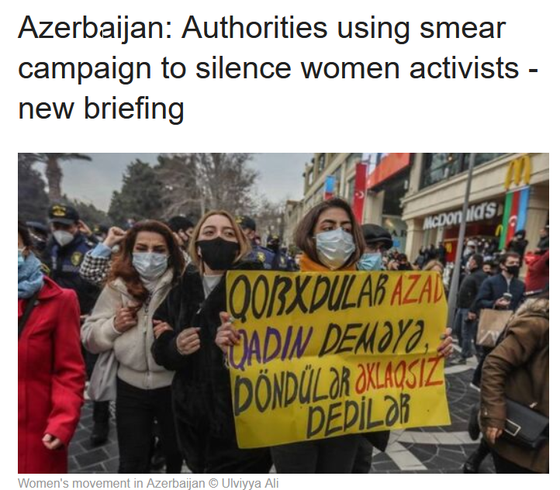
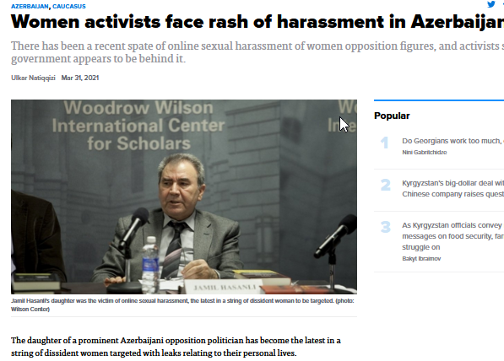
GENERAL MEASURES
Ongoing practice of surveillance, blackmail and smear campaign against journalists, gender activists, family members of political figures, women politicians
Dozens of activists, journalists, lawyers, now in the process of demanding investigation into Pegasus spyware attack in Azerbaijan
Notes:
16

Slide 17
GENERAL MEASURES
New Media Law is restrictive and opens new avenues for persecution against journalists who criticize the government:
Convicted people (like myself), people with no higher education are banned from being in management positions in journalism.
Requires approval from law enforcement agencies in publishing stories about their anti-extremism operations - not only for the text, but also the format of the publication.
=> journalists will not be able to document police misconduct
Law introduces registry of the journalists
No opportunity for freelancers to get the journalist badge and accreditation.
Risk of being charged with illegal entrepreneurship for freelancers
More comprehensive analysis of the law is here: https://csometer.info/updates/azerbaijan-
brief-overview-new-media-law
Notes:
17

Slide 18
Recommendations
Reopen and conduct the investigation in respect of the interferences with my private life in a manner that is consistent with international human rights standards
Immediately and comprehensively take such action as will ensure that all private content relating my private life that was the subject matter of this case, not least the details disclosed by the prosecutor in the context of the criminal investigation, be permanently removed from online sources;
Quash my criminal conviction and ensure removal of my conviction from state registry
Recalling Recommendation CM/Rec(2022)4 of the Committee of Ministers to member States on promoting a favorable environment for quality journalism in the digital age as well as a positive obligation of the State to create a favorable and enabling environment, ensure safety and security of journalists, take immediate steps in order to effectively guarantee the freedom of expression and safety of journalists in Azerbaijan, and amend the domestic legislation accordingly.
Notes:
18

Slide 19
Recommendations
Ensure that the effective investigation is carried out in respect of the threatening letter, the secret filming and dissemination of intimate videos by unidentified persons as well as the public disclosure of the personal information in the authorities’ report on the status of investigation.
Ensure that, inter alia, concrete steps are taken to identify the perpetrator, and have the authorities send an inquiry regarding the account opened in Interkommerzbank in Russia to find out information about the owner of the bank card;
Compensation for travel ban and asset freezing
Return of tax liability enforced against me as a result of illegal conviction
Ensure the justice in the tax case against Radio Free Europe/Radio Liberty and create conditions for their activity
Ensure that the journalists are not being subject to criminal prosecution for the lack of accreditation in Foreign Ministry, ensure the accreditation procedures are transparent and effective.

Slide 20
Thank you for your attention
Q and A
Strasbourg
30 May 2022
Notes:
20

