Slide 1
EIN Civil Society Briefing Parascineti v. Romania
Cristian Teodorescu v. Romania
N. v. Romania
R.D. and I.M.D. v. Romania
Center for Legal Resources on behalf of Valentin Câmpeanu v. Romania
By Georgiana Pascu, Program Manager at Centre for Legal Resources 25th May 2023, Strasbourg
Notes:
Case Description:
1) The case concerns the authorities’ failure to protect the right to life of Mr Câmpeanu, a young man of Roma origin, orphaned, HIV-positive and with “severe intellectual disability” (substantial violation of Article 2). The European Court found serious shortcomings in the social and medical care afforded to him before his death at the forensic psychiatric hospital of Poiana Mare in 2004, namely:
- the authorities’ failure to designate a form of legal protection for him after he attained majority;
- the decisions taken by the social services and medical authorities as regards his placement once he attained majority, which were based on the willingness of the facilities to receive him and not on their ability to provide appropriate medical treatment, without adequate diagnosis and monitoring and in disregard of his health condition and his most basic medical needs;
- the failure to apply the legal procedure and safeguards for involuntary psychiatric placement when placing (secluded) him in Poiana Mare Hospital;[2]
- the difficult living conditions in Poiana Mare Hospital, as well as the failure of the staff to provide him with appropriate care and treatment for his psychiatric and somatic pathologies, including antiretroviral treatment (lack of heating, food and medicines).
2) The case also concerns the ineffectiveness of the investigation and the court proceedings into Mr Câmpeanu’s death, due to the authorities’ failure to conduct an immediate autopsy, to establish whether the death could have been the result of an inadequate therapeutic approach or to take into account the objective situation prevailing in Poiana Mare Hospital (procedural violation of Article 2).
3) Finally, it highlights the lack in domestic law of a legal framework suited to the specific needs of people with mental disabilities and allowing for the examination of the allegations concerning the violation of Mr Câmpeanu’s right to life by an independent authority (violation of Article 13 taken together with Article 2).
Under Article 46 of the Convention, the Court indicated that it was necessary to adopt measures to ensure that “mentally disabled persons in a situation comparable to that of Mr Câmpeanu are afforded independent representation, enabling them to have Convention complaints relating to their health and treatment examined before a court or other independent body” (§ 161 of the judgment).
Serious shortcomings in the social and medical care afforded to him before his death at the psychiatric hospital of Poiana Mare in 2004:
- failure to designate a form of legal protection for him after he attained majority;
- the decisions taken by the social services and medical authorities as regards his placement once he attained majority, which were based on the willingness of the facilities to receive him and not on their ability to provide appropriate medical treatment, without adequate diagnosis and monitoring and in disregard of his health condition and his most basic medical needs;
- the failure to apply the legal procedure and safeguards for involuntary psychiatric placement when placing him in Poiana Mare Hospital;
- the difficult living conditions in Poiana Mare Hospital, as well as the failure of the staff to provide him with appropriate care and treatment for his psychiatric and somatic pathologies, including antiretroviral treatment.
1

Slide 2
Parascineti v. România and Cristian Teodorescu v. Romania
applications no. 32060/05 and 22883/05,
judgments 13/06/2012 and 19/09/2012
Notes:
2

Slide 3
Parascineti v. România
Ill-treatment and inhuman and degreading living conditions during involuntary placement in the psychiatric unit of the Municipal Sighetu Marmaţiei Hospital
Seclusion room, overcrowding, poor sanitary and hygiene conditions, absence of an individual bed, and the impossibility to spend time outdoors due to staff shortages.

Slide 4
Parascineti v. Romania Seclusion room – Sighetu Marmației

Slide 5
Parascineti v. România Conditions in psychiatric hospitals
16,073 psychiatric beds nationwide
4 security (forensic) psychiatric hospitals
Chronic wards accommodate more than 8000 patients
Notes:
the lack of specialized staff and significant underfunding; situations with a high risk of injury, self-harm and aggression; major procedural difficulties in admitting patients, in relation to the ambulance service; exclusive drug therapy (without psychotherapeutic programs); difficulties in managing involuntary admissions; discrimination based on diagnostic criteria by overcrowding the psychiatric wards at Sighetu Marmației, with the most difficult to manage psychiatric patients in the county
Reportaj DIGI – Carla -
5

Slide 6
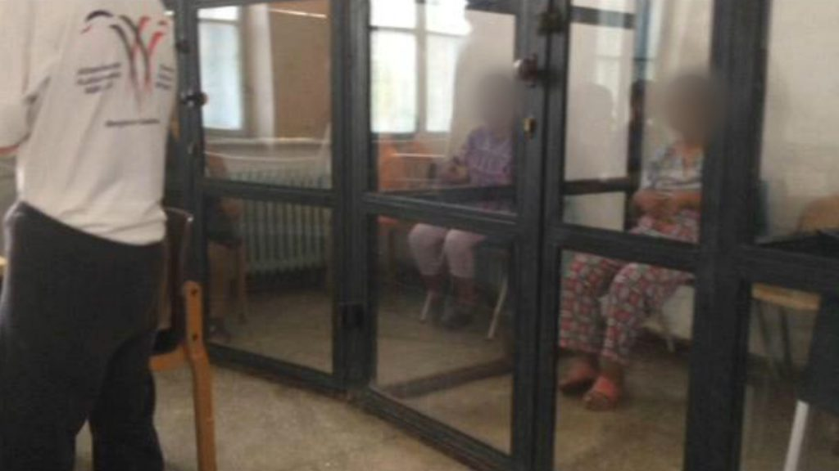
Parascineti v. România:
September 2019 & 2020 CLR follow-up visit
8 residents locked in 6 cages
Tied with shirts and strips of cloth
Lack of specialized staff and significant underfunding
Situations with a high risk of injury, self-harm and aggression
Notes:
Situations with a high risk of injury, self-harm and aggression
Major procedural difficulties in admitting patients, in relation to the ambulance service
Exclusive drug therapy (without psychotherapeutic programs); difficulties in managing involuntary admissions

Slide 7
Parascineti v. România Lack of adequate health care services and staff Inefficient investigations of the causes of deaths - Botoșani
24 May 2023: A man aged just 47, brought in to withdraw, died before doctors' eyes. They called an ambulance, but it was too late. The man was in ethanolic withdrawal at the psychiatric ward - acute ward.
28 Nov. 22: patient died after choking on food
15 June 2022: an 18-year-old patient stabbed himself in the chest with a knife. He had several admissions to psychiatrists. The ambulance with emergency doctors could not save him.
24 March 2023:
An 87-year-old patient died in the hallway of the medical unit without anyone jumping to his aid.
On Thursday morning, around 5am, a nurse found him dead in the main hallway on the ground floor. Three hours earlier, a nurse had administered the treatment in a ward on the third floor - in the "Medical" section.
What happened to the patient in the meantime, no one in the hospital knows. The manager shrugs when asked when the old man left the ward
Notes:
https://www.monitorulbt.ro/prima-pagina/2023/05/24/ancheta-dupa-un-deces-misterios-la-psihiatrie/A new death shrouded in mystery at the psychiatric ward, Botosani.
An outrageous situation at the Emergency County Hospital in Botosani.

Slide 8
Cristian Teodorescu v. Romania
Unlawful placement in psychiatric hospitals
Shortcomings in legislative framework governing the procedure and safeguards in the field of involuntary psychiatric placement and more general problems which affected the application of this framework

Slide 9
Cristian Teodorescu v. Romania
Failure to comply with Mental Health Act procedure and placement without justification relating to their mental health condition Failure to comply with the legal requirement to obtain consent for medical treatment
Inconsistent knowledge among healthcare professionals about the relevant procedures

Slide 10
Cristian Teodorescu v. Romania Unlawful involuntary placements in psychiatric hospitals
No mental health department within the MoH
MoH has not requested EU budget for the mental health community services (Cohesion Policy budget)
Latest communication (March 2023) from authorities does not refer to the living conditions and rights of persons in psychiatric hospitals
No public data on involuntary placements in psychiatric hospitals and the transfers between social and psychiatric system
Notes:
In that period, of the 524 involuntary admissions reported, only 112 were referred to the courts in order to examine and confirm the involuntary placement through a judicial decision, according to art. 61 para. 6 of the Mental Health Act (Law no. 487/2002).
In all 112 cases, the commission's involuntary placement decision was confirmed by the court, and there was not even a single case in which it overturned the decision of involuntary placement. Of these 112 people hospitalized involuntarily, only 6 have declared an appeal, which was rejected each time.
The rest of the involuntarily hospitalized persons did not benefit from a judicial review of the decision taken by the medical commission. In is unclear what kind of legal aid these persons (subjected to the measure of involuntary confinement) benefited from, considering that, in all 524 reported cases referred to the courts, the measure proposed by the medical commission was confirmed. The ex officio defense that persons with mental health problems benefit from in these circumstances does not seem to be effective, considering that only 6 people admitted involuntarily have appealed (unsuccessfully).
10

Slide 11
Cristian Teodorescu v. Romania Unlawful involuntary placements in psychiatric hospitals
CLR 2018 data (only some hospitals responded):
524 involuntary admissions => Only 112 were referred to the courts for judicial review
Not even a single case in which court overturned the decision of involuntary placement
206 people came from residential centers for people with disabilities.
2139 "social cases“

Slide 12
Cristian Teodorescu v. Romania Unlawful involuntary placements in psychiatric hospitals
Lack of progress at national level
Lack of community-based mental health and social care services => involuntary placements and de facto involuntary placements used as measure of “first resort” => system overload => overcrowding and low compliance with procedural guarantees
The non-existence of an independent body with monitoring, control and sanction powers
CLR cooperation protocol with the Ministry of Labour and Social Solidarity rescinded due to reports and criminal complaints filed by the CLR following abuses in social care private homes financed with local authority money
Notes:
A large number of involuntarily hospitalized people are being admitted from the residential centers for persons with disabilities, being transferred to psychiatric hospitals when their behavior becomes difficult for the staff to manage. Thus, from the data collected by CLR in 2018, it was observed that, from the total of involuntary admissions, a number of 206 people came from residential centers for people with disabilities. Out of these, only 26 people were presented to the courts for confirmation of the measure of involuntary placement, although the patient's participation and listening in these proceedings is mandatory.
Court decisions confirming the measure of internment was delivered only for 33 of the 206 involuntarily hospitalized people from the centers residential for disabled people. It can thus be observed that when the patient comes from a residential center for persons with disabilities, this aspect negatively influences the degree of compliance with guarantees procedures regarding involuntary hospitalization provided by the Mental Health Law.
In the data monitoring period, there were 7 cases in which requests for involuntary medical hospitalization were dismissed by the courts as having remained without object, since the patient had in the meantime been discharged. This happens when the court has been notified by the management of the medical unit outside the legal term of 4 days¹⁸ , and the patient has benefited, in the meantime, from a favorable assessment by the commission, being released, or when the court did not process with sufficient urgency.
Social cases
According to the data collected by CLR between October 2017 and September 2018, in psychiatric hospitals and psychiatric wards in the country, there were 2139 "social cases", persons who had no relatives or who have been abandoned by their families, without income or housing. For these patients, it is necessary to identify a protective measure in the family or in the community, but in the absence of it, they remain hospitalized for an unlimited period in the psychiatric hospital.
In the monitoring period, the hospitals notified the social assistance services in order to identify a solution for 1030 of these cases. The responses received from the social welfare services are often limited to indicating the lack of available places in residential centers and the lack of funds, sometimes proposing to maintain admission, or even remaining unanswered. Thus, "social cases" patients are abandoned in the hospital, deprived of freedom and the prospect of reintegration into the community.
Today, there is no indication that the situation has improved.
12

Slide 13
Recommendations Parascineti v. Romania and Cristian Teodorescu v. Romania
Urge the national authorities to provide a concrete action plan for the implementation of these judgments
Increase the frequency of examination of these cases
Instruct the Secretariat to prepare an interim resolution
Request data on the number of patients with mental disabilities treated in emergency wards of county hospitals
Request the authorities to equip psychiatric wards with equipment for emergency medical interventions.
Notes:
Having in mind the seriousness of the human rights violations identified in this group of cases, which affect thousands of extremely vulnerable persons with mental health disabilities living in psychiatry hospitals, deprived of their liberty and with restricted access to justice; the fact that these judgments have been pending implementation for over 10 years, and the government’s passivity on these issues, taken together with the lack of a concrete action plan and updated interim measures, CLR kindly requests the Committe of Ministers to urge the national authorities to provide a concrete action plan for the implementation of these judgments, to increase the frequency of examination of these cases and to instruct the Secretariat to prepare an interim resolution. Furthermore, CLR recommends that the Committee of Ministers request the authorities to:
Request the authorities to urgently provide information on the reflection process which was initiated in 2020 regarding the legislative changes needed to address the shortcomings of the procedure and guarantees in the field of non-voluntary admissions, as well as on the state of play of the monitoring activity of the interdepartmental monitoring group
13

Slide 14
Recommendations Parascineti v. Romania and Cristian Teodorescu v. Romania
Request the authorities to:
Provide recent disaggregated statistics on non-voluntary admission procedures in psychiatric hospitals and units since 2018
Adopt a concrete legislative framework on access to justice of non-voluntary hospitalizations and investigate the causes of deaths
Urgently allocate of a concrete budget plan for the community psychiatry system.
Appoint a coordinator at government level for the execution of the obligations arising from the judgments of the ECtHR against Romania in the field of psychiatry and mental health.
Notes:
Having in mind the seriousness of the human rights violations identified in this group of cases, which affect thousands of extremely vulnerable persons with mental health disabilities living in psychiatry hospitals, deprived of their liberty and with restricted access to justice; the fact that these judgments have been pending implementation for over 10 years, and the government’s passivity on these issues, taken together with the lack of a concrete action plan and updated interim measures, CLR kindly requests the Committee of Ministers to urge the national authorities to provide a concrete action plan for the implementation of these judgments, to increase the frequency of examination of these cases and to instruct the Secretariat to prepare an interim resolution. Furthermore, CLR recommends that the Committee of Ministers request the authorities to:
14

Slide 15
N. v. Romania application no. 59152/08, judgment 28/02/2018
Non-voluntary psychiatric confinement as a security measure during criminal investigations:
Absence of a legal basis for the applicant’s deprivation of liberty
Shortcomings in the proceedings for the judicial review of the applicant’s deprivation of liberty (speediness, legal assistance, no opportunity to speak during hearings)
ECtHR recommended general measures to ensure that:
Detention of persons in psychiatric hospitals is legal, justified and not arbitrary
Any person detained in such institutions has the right to initiate proceedings that provide adequate guarantees to obtain a prompt judicial decision on the lawfulness of their detention.
Notes:
This case concerns the psychiatric confinement of the applicant, who has been diagnosed with a psychiatric condition. Although the detention was first imposed in 2001 as a security measure during criminal investigations, the Court only examined the situation from 2007 onwards, as the complaints about the earlier period were out of time.
Absence of a legal basis for the applicant’s deprivation of liberty (violation of Article 5 § 1)
The Court found that the applicant’s deprivation of liberty between 2007 and 2016 was devoid of legal basis, mainly because the domestic courts had failed to assess the danger he posed to society, which was an essential element under domestic law, but instead based themselves only on forensic medical reports attesting that he had a psychiatric condition. In addition to being contrary to domestic law and Article 5 § 1, the detention was inconsistent with the principle that the sole existence of a disability shall in no case justify a deprivation of liberty, laid down in the United Nations Convention on the Rights of Persons with Disabilities.
The Court moreover held that the applicant’s deprivation of liberty after 2016 had been arbitrary. It noted that in 2016, in the absence of any legal provision to allow it, the domestic courts provisionally continued his detention to give time to the social services to organise his transfer to an institution suited to his needs. Furthermore, a court decision delivered in February 2017, replacing the measure of psychiatric confinement with that of mandatory treatment and ordering the applicant’s release, remained unimplemented at the time of the Court’s judgment. This was due to the authorities’ failure to carry out a rigorous assessment of the applicant’s specific needs and of the social welfare measures that would be appropriate, and to the lack of suitable reception facilities.
Shortcomings in the proceedings for the judicial review of the applicant’s deprivation of liberty (violation of Article 5 § 4)
The Court found that these proceedings had not afforded sufficient safeguards against arbitrariness. It considered that the intervals at which the domestic courts had assessed the need to continue the detention had not satisfied the requirement of speediness and that the applicant had not had effective legal assistance, as he was represented by a different lawyer in each set of proceedings and did not have the opportunity to speak to them before the hearings.
15

Slide 16
R.D. and I.M.D. v. Romania application no. 35402/14, judgment. 12/10/2021
Unlawful psychiatric confinement as a security measure for the purpose of compelling them to undergo medical treatment
Measure was imposed following criminal proceedings condemning the applicants to compulsory psychiatric treatment, based on medical reports of expertise dated 3 years before the date of confinement in the psychiatric hospital without proper examination by the domestic courts of the degree of social danger justifying the safety measure or of the degree of social danger of the criminal offense.
Absence of a legal framework concerning the obligation to undergo medical treatment: Criminal Code does not offer to people diagnosed with a psychiatric condition sufficient guarantees against arbitrariness as concerns the administration of medical treatment
Notes:
The case concerns the non-voluntary confinement of the applicants in a psychiatric hospital, from 30 December 2014 onwards, for the purpose of compelling them to undergo medical treatment and about the obligation to undergo that medical treatment. The measure was imposed following criminal proceedings condemning the applicants to compulsory psychiatric treatment, based on medical reports of expertise dated 3 years before the date of confinement in the psychiatric hospital and further maintained until present, without proper examination by the domestic courts of the degree of social danger justifying the safety measure or of the degree of social danger of the criminal offense.
As concerns the medical treatment, the existing applicable legal basis concerning this safety measure (Article 109§2 of the 2014 Criminal Code and Article 568 § 1 of the 2014 Criminal Procedure Code) does not offer to people diagnosed with a psychiatric condition sufficient guarantees against arbitrariness as concerns the administration of medical treatment, taking into consideration that, according to the Government’s observations, Law no. 487/2002 regarding mental health does not apply in such cases and that the procedure regarding guardianship is also lacunar.
16

Slide 17
N. v. Romania and R.D. and I.M.D. v. Romania
No legislative provisions to set clear limits on when and under what conditions a non-voluntary psychiatric confinement (as security measure) can be taken
Many involuntary placement measures which are not legal, are arbitrary and unjustified
Lack of safeguards: persons with mental health conditions who commit criminal acts without discernment and are placed in forensic psychiatric hospitals receive a “life sentence”
June 2020:
1,424 persons admitted to psychiatric and security measures hospitals
approximately 14% had a disability certificate (the majority having mental disabilities).
80% of the people admitted were reported as having a mental disability
Without disability certificates they cannot receive procedural adaptations
Notes:
17

Slide 18
N. v. Romania and R.D. and I.M.D. v. Romania
Inconsistencies between the relevant legislative provisions and the factual situation
Provisions of the Criminal Code in force (art. 109 and 110) stipulate that both the obligation to medical treatment and hospitalization are taken "until recovery or until an improvement is obtained that removes the state of danger" - in this situation the Romanian authorities have not yet identified a solution that is applicable to persons with intellectual disabilities
Persons with intellectual or psychosocial disabilities under involuntary confinement security measures risk being detained for life.
Medical confinement
No clear procedure applicable for the re-examination or changing of measures for medical confinement, as regards the periodicity of medical examinations.
No legislative framework to ensure legal aid in this area
No dedicated spaces and services for the needs of persons with mental health conditions who are currently detained in forensic psychiatric hospitals, and whose detention review would lead to their release.
Notes:
18

Slide 19
Recommendations N. v. Romania and R.D. v. I.M.D. v. Romania
Adopt of a legislative framework to regulate in concrete terms the situation of persons subjected to security measures (involuntary confinements in forensic psychiatric hospitals and medical confinements) and the need for periodic reassessments, in order to ensure that they do not remain in psychiatric hospitals indefinitely.
Enact a clear legislative framework to regulate the situation of persons subjected to security measures and to ensure legal assistance for persons with mental health conditions subjected to security measures (and all mental health institutions).
Amend the Criminal Code to identify a solution applicable to persons with intellectual or psychosocial disabilities, for whom "the full recovery" is not possible, and to provide them with sufficient guarantees against arbitrariness in the administration of medical treatment.
Carry out regular monitoring visits to forensic psychiatric hospitals and communicate the conclusions of the monitoring visits to the Committee of Ministers in order to have a close observation of the developments on the ground.
Notes:
19

Slide 20
Center for Legal Resources on behalf of Valentin Câmpeanu v. Romania, application No. 47848/08, judgment 17/07/2014
Authorities’ failure to protect the right to life of a young man, orphaned, HIV-positive and with “severe intellectual disability”.
2) Ineffectiveness of the investigation and the court proceedings into his death
3) Lack in domestic law of a legal framework suited to the specific needs of people with mental disabilities and allowing for the examination of the allegations concerning the violation of Mr Câmpeanu’s right to life by an independent authority
Romania must adopt measures to ensure that “persons with mental disabilities in a situation comparable to that of Mr Câmpeanu are afforded independent representation, enabling them to have Convention complaints relating to their health and treatment examined before a court or other independent body”.
Notes:
Case Description:
1) The case concerns the authorities’ failure to protect the right to life of Mr Câmpeanu, a young man of Roma origin, orphaned, HIV-positive and with “severe intellectual disability” (substantial violation of Article 2). The European Court found serious shortcomings in the social and medical care afforded to him before his death at the neuropsychiatric hospital of Poiana Mare in 2004, namely:
- the authorities’ failure to designate a form of legal protection for him after he attained majority;
- the decisions taken by the social services and medical authorities as regards his placement once he attained majority, which were based on the willingness of the facilities to receive him and not on their ability to provide appropriate medical treatment, without adequate diagnosis and monitoring and in disregard of his health condition and his most basic medical needs;
- the failure to apply the legal procedure and safeguards for involuntary psychiatric placement when placing him in Poiana Mare Hospital;[2]
- the difficult living conditions in Poiana Mare Hospital, as well as the failure of the staff to provide him with appropriate care and treatment for his psychiatric and somatic pathologies, including antiretroviral treatment.
2) The case also concerns the ineffectiveness of the investigation and the court proceedings into Mr Câmpeanu’s death, due to the authorities’ failure to conduct an immediate autopsy, to establish whether the death could have been the result of an inadequate therapeutic approach or to take into account the objective situation prevailing in Poiana Mare Hospital (procedural violation of Article 2).
3) Finally, it highlights the lack in domestic law of a legal framework suited to the specific needs of people with mental disabilities and allowing for the examination of the allegations concerning the violation of Mr Câmpeanu’s right to life by an independent authority (violation of Article 13 taken together with Article 2).
Under Article 46 of the Convention, the Court indicated that it was necessary to adopt measures to ensure that “mentally disabled persons in a situation comparable to that of Mr Câmpeanu are afforded independent representation, enabling them to have Convention complaints relating to their health and treatment examined before a court or other independent body” (§ 161 of the judgment).
Serious shortcomings in the social and medical care afforded to him before his death at the neuropsychiatric hospital of Poiana Mare in 2004:
- failure to designate a form of legal protection for him after he attained majority;
- the decisions taken by the social services and medical authorities as regards his placement once he attained majority, which were based on the willingness of the facilities to receive him and not on their ability to provide appropriate medical treatment, without adequate diagnosis and monitoring and in disregard of his health condition and his most basic medical needs;
- the failure to apply the legal procedure and safeguards for involuntary psychiatric placement when placing him in Poiana Mare Hospital;
- the difficult living conditions in Poiana Mare Hospital, as well as the failure of the staff to provide him with appropriate care and treatment for his psychiatric and somatic pathologies, including antiretroviral treatment.
20

Slide 21
Center for Legal Resources on behalf of Valentin Câmpeanu v. Romania
Legal protection for vulnerable adults
Relevant developments at national level: Law no. 140/2022 which regulates the protection measures for people with intellectual and/or psychosocial disabilities
MoJ: approx. 90.000 cases involving the judicial protection of ”incapable” adults
Concerns regarding the implementation Law no. 140/2022 :
Lack of training of the professionals working with persons with disabilities
Methodology is hindering the process: high costs and expenses are not supported from the national health fund;
Lack of concrete and clear information regarding the mechanism for conducting medical and psychosocial evaluation reports
The norm which states that the institution of the personal representative will be regulated by a special law has still not been drafted
Notes:
1000 euro cost of two evaluations
Suspended causes if the person can’t pay the cost of the evaluation
Psychiatric and psychologist evaluations can’t be done within the public health and social system due to a provision introduced by the Professional Body of Psychologists
21

Slide 22
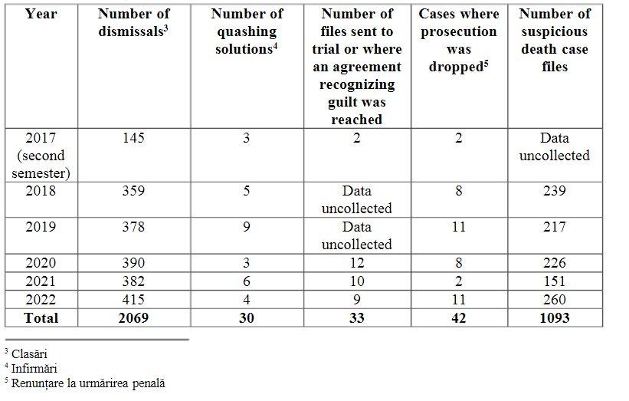
Center for Legal Resources on behalf of Valentin Câmpeanu v. Romania, Effectiveness of criminal investigations
Data provided by the authorities (table on the right) refers to the number of suspicious death case files but not the number of deaths in institutions.
No information on the number of convictions
CLR data on no. of annual deaths in mental health institutions
Example: young woman with mental disabilities with broken femur for months at Zătreni social care home
Data provided by the Romanian authorities in latest communication to the CM
Notes:
22

Slide 23
Deaths in 67 psychiatric units with 8064 beds (2019)
336 patients died
Causes of death:
Lung disease 73
Asphyxia 17
Heart disease 175
Tumors 7
Suicide 4
Other causes 60
215 notifications of deaths
to the Monitoring Council established : 54
to police/prosecutor 183
to other institutions 15
Notes:
Voluntary addmitted
Number of deaths registered during 2019 that were notified
to the Monitoring Board established under Law No 8/2016

Slide 24
Deaths in social care homes (2022, Council of Monitoring)
1029 adults of which:
835 persons had a disability certificate
101 people did not have a disability certificate
for 103 deceased persons, the social assistance institutions did not communicate information on disability classification

Slide 25
Number of people admitted to psychiatric hospitals (2019)
Total number of persons admitted, of which | 6,507
Inpatients for at least 3 months | 1,253
Inpatients for at least 6 months | 1,821
Urban - Total number of persons admitted, of which: | 4,860
Inpatients at least 3 months | 1,074
Inpatients for at least 6 months | 663
Rural - Total number of inpatients, of which: | 1,647
Inpatients at least 3 months | 580
Inpatients at least 6 months | 747

Slide 26
Center for Legal Resources on behalf of Valentin Câmpeanu v. Romania
Transfer from social home to psychiatric ward of a young man with intellectual and psychosocial disabilities
Consent for publication of this photo was obtained by CLR

Slide 27
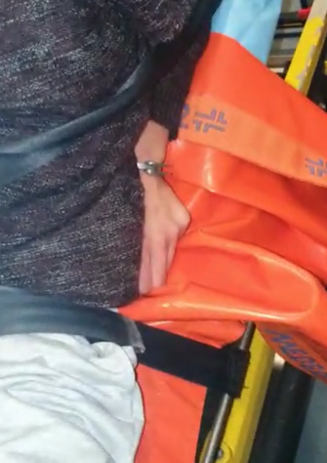
Consent for publication of these photos were obtained by CLR
Notes:
Major procedural difficulties in admitting patients, in relation to the ambulance service
Exclusive drug therapy (without psychotherapeutic programs); difficulties in managing involuntary admissions

Slide 28
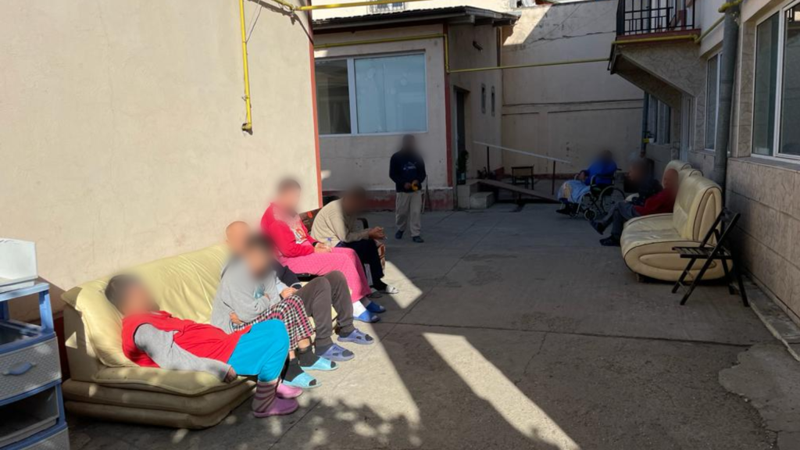
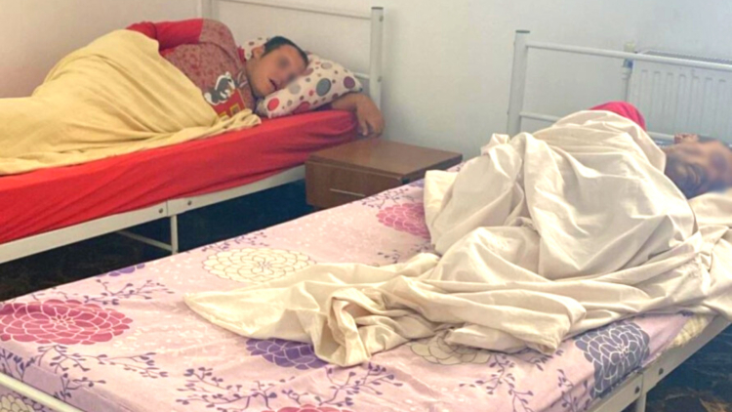
Example: Ilfov County – deprivation of liberty, inhumane and degreading conditions in a private social home financed by local authorities

Slide 29
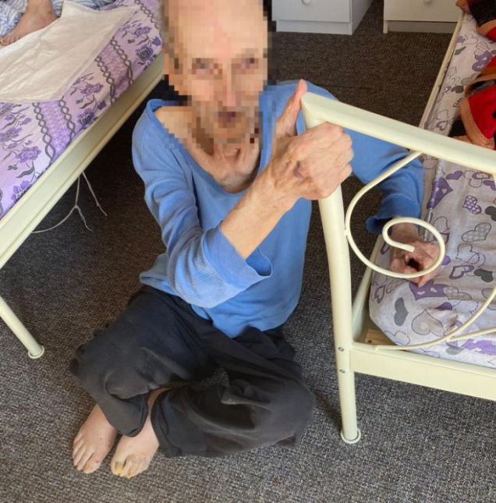
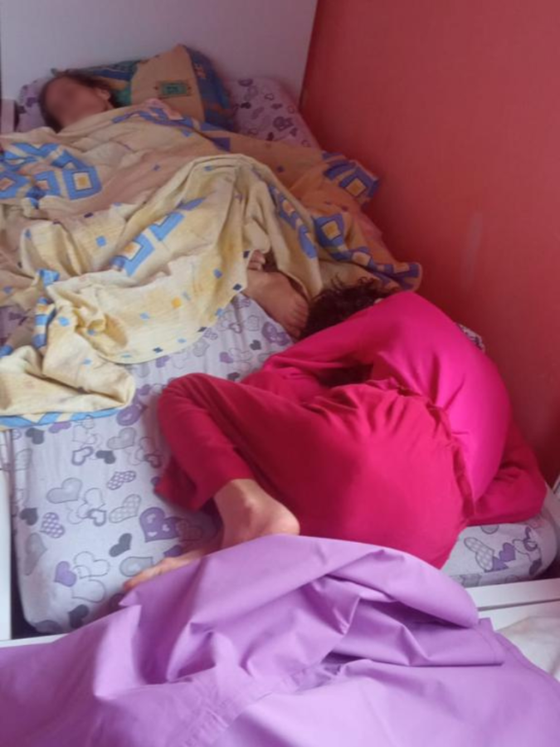

Slide 30
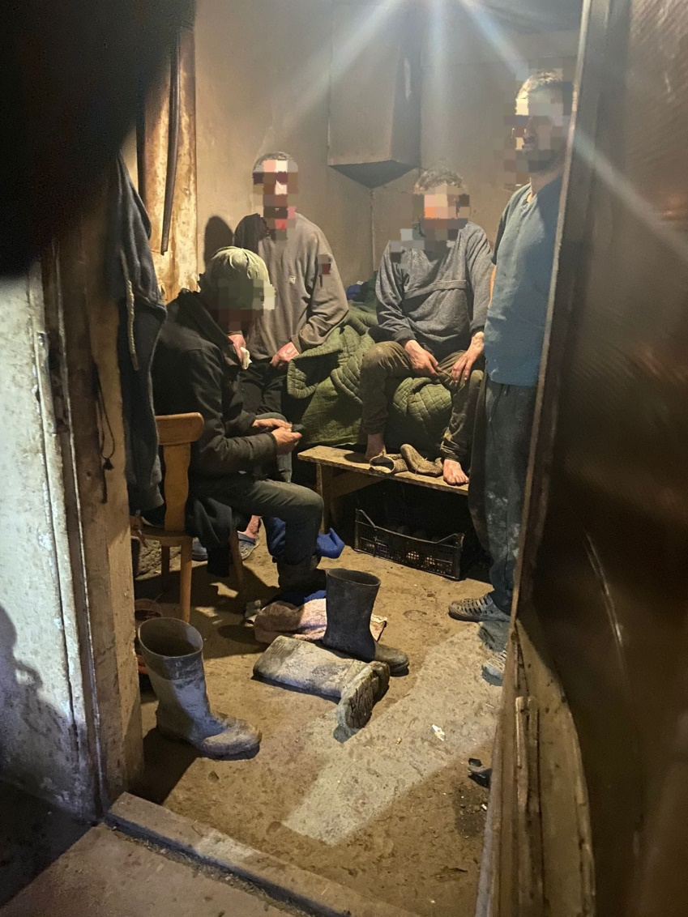
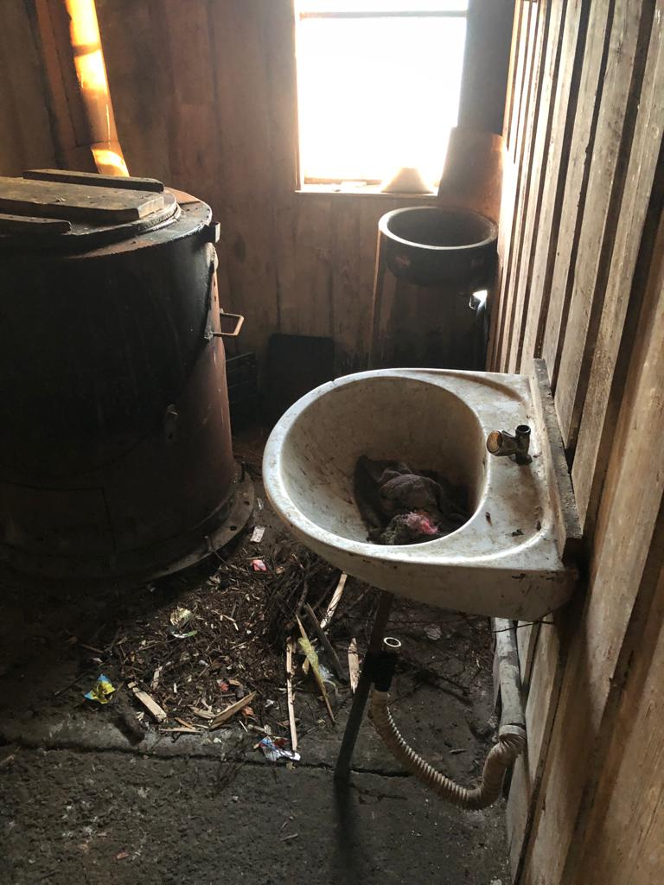
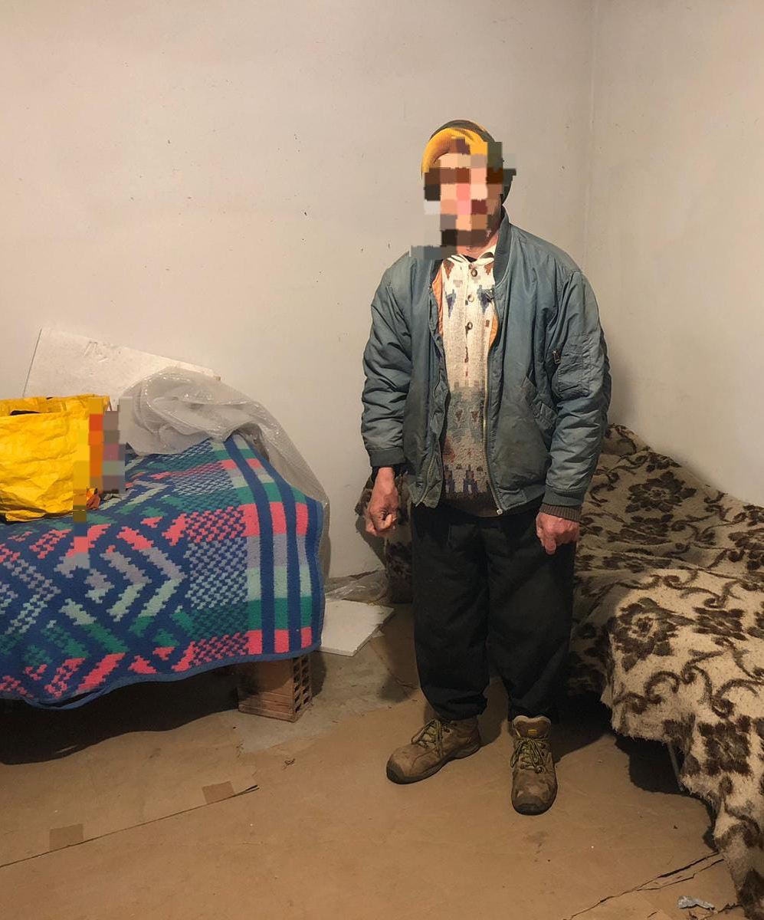
Vrancea – Maramures – human traficking led by the head of a public social care home

Slide 31
Center for Legal Resources on behalf of Valentin Câmpeanu v. Romania Safeguards and remedies regarding placement in residential social care facilities and
psychiatric hospitals
The Council of Monitoring is still not fully operational (Law no. 8/2016)
The manner and extent to which its decisions can be appealed, the so-called “grey area of consent”
Non-transparent procedure of transfers between social homes to psychiatric units – social homes and back
Lack of informed consent
Notes:
This type of transfer in being unfortunately conducted not only between social care homes, but also between psychiatric hospitals and social care facilities.
The placement of people in residential social care is being carried out after the assessment made by the County Commission for the Evaluation of Adults with Disabilities -
Persons transferred from one residential centre to another without their consent, without even being informed where they would go, and obviously without being asked for their consent as to whether or not they wanted to be moved.
In the few cases when people are informed about their transfer, their consent is neither asked for nor taken into consideration if expressed.
31

Slide 32
Recommendations Center for Legal Resources on behalf of Valentin Câmpeanu v. Romania
Elaborate the law that regulates the institution of the personal representative and the provision of the necessary funds so that this can effectively contribute to the access to justice and deinstitutionalization process (Law no. 140/2022)
Allocate the budget for carrying out psychiatric and psychological assessments of people in need it of supported decision measures (mandatory requested by the court)
Ensure, through the institutions responsible for the ongoing training of magistrates and lawyers, at least one training course per year in the field of adequate communication with persons with intellectual disabilities /or psychosocial disabilities.
Allocate adequate resources for staff and logistics of the Monitoring Council so that the institution can ensure the effective representation of persons with disabilities in the defense of their fundamental rights and freedoms and ensure their access to justice.
Notes:
32

Slide 33
Recommendations Center for Legal Resources on behalf of Valentin Câmpeanu v. Romania
Establishing proper collaboration with the human rights organisations and self-representatives and allowing unrestricted access to public and private residential social centers and hospitals or psychiatric wards so that the objective monitoring of the respect for the rights of persons with disabilities can be carried out.
Regulate and develop social services in the community and community psychiatry in order to effectively prevent the medical and social neglect of vulnerable patients in psychiatric hospitals and social care homes and to achieve the deinstitutionalization indicator foreseen in Law 7/2023, and ensure that sufficient funding is allocated to communities and local authorities to support these services and the implementation of Law no. 7/2023.
Notes:
33

Slide 34
Recommendations Center for Legal Resources on behalf of Valentin Câmpeanu v. Romania
Systematically collect and publish data on cases involving people with disabilities by the responsible authorities (The National Union of Romanian Bar Associations, Public Prosecutor’s Office, Courts of Appeal, Monitoring Council, Psychiatric Hospitals and Residential Social Care Centres).
Develop concrete and standard complaint mechanisms accessible to people with disabilities institutionalized
Notes:
34

