Slide 1
Update on the Status of Implementation of Oya Ataman Group cases
Beril Önder on behalf of The Turkey Human Rights Litigation Support Project (TLSP)
Mümtaz Murat Kök on behalf of Media and Law Studies Association (MLSA)

Slide 2
Oya Ataman Group Cases (Oya Ataman v. Turkey 74552/01 and 74 repetitive cases)
Update on the Status of Implementation
Joint Rule 9.2 Communication of 23 January 2023 by TLSP and 25 other NGOs + 7 Bar Associations
MLSA Rule 9.2 Communication of 5 January 2023

Slide 3
Oya Ataman Group Cases
A group of 75 cases concerning the right to peaceful assembly (Article 11) including
the prosecution of participants in demonstrations
the use of excessive force to disperse peaceful demonstrations
The cases also concern violations of Articles 2, 3, 5, 10, 11 and 13 of the Convention
unjustified detention orders imposed on the participants
the failure to carry out effective investigations into the applicants’ allegations of ill- treatment and the lack of an effective remedy in this respect
Pending for 16 years

Slide 4
Committee of Ministers (CM) General Measures
September 2021:
‘Legislative reform is indispensable to ensure the enjoyment of freedom of peaceful assembly in Turkey’
No proposal for legislative amendment has been made after the examination of this group in 2019 despite the clear indications of the Committee
The need to amend the Law No. 2911 to ensure that its provisions are fully in line with the principles set out in the case law of the European Court and the Constitutional Court
The need to review the 2016 directive on the use of tear gas and other crowd control weapons to ensure that it complies in all respects with international standards in relation to the use of crowd control weapons

Slide 5
1- Joint Rule 9.2 Communication of 23 January 2023 by 26 NGOs and 7 Bar Associations

Slide 6
Update on Legislative Developments: Law No.2911 on Demonstrations and Public Meetings
Law No. 2911 allows local authorities to:
impose unwarranted restrictions on the right of peaceful assembly;
impose blanket bans on all demonstrations and events;
enforce dispersal and impose criminal and administrative sanctions against those who attempt to exercise their right to peaceful assembly.
Lack of any comprehensive legislative measures in fully aligning Law 2911 with Convention standards for 16 years.
The amendments made between 2014-2018 to Law No. 2911 have already been examined by the CM in its previous meetings: they are not Convention-compliant

Slide 7
Update on Legislative Developments: Additional restrictions in the aftermath of state of emergency
After the attempted coup d’état of 15 July 2016, under the state of emergency, Article 11 of Law No. 2935 on the state of emergency granted broad powers to governors, restricting the freedoms of assembly and movement along with other freedoms, which significantly affected civil society activities.
Severe restrictions such as blanket bans on peaceful assemblies were frequently imposed

Slide 8
Update on Legislative Developments: Additional restrictions in the aftermath of state of emergency
Although the State of emergency formally ended on 18 July 2018, serious restrictions placed under the emergency regime were incorporated into permanent legislation.
On 25 July 2018, Law No. 7145 (an ‘omnibus law’) introduced emergency-type restrictive measures into several ordinary laws.
Amendments to Articles 6 and 7 of Law no. 2911
An amendment to Article 11 (C) of Law No. 5442 on Provincial Administration (allowing provincial governors to ban the entry or exit of individuals to their provinces for fifteen days).

Slide 9
Application and interpretation by the domestic authorities of the domestic law
Blanket and specific bans on demonstrations and events
Police interventions with excessive use of force
Criminalisation of peaceful protestors

Slide 10
General (Blanket) Bans
Under Law No. 2911 and Law No. 5442, provincial governors have regularly imposed bans on demonstrations and events in many provinces
Some governors automatically extended an existing ban by imposing another ban at the end of the previous one, creating an uninterrupted ban for a period much longer than 30 days.
In the Eastern city of Van, a general ban on all public gatherings and events was first imposed on November 21, 2016, and with the additional bans introduced by the authorities, all public gatherings and events were banned uninterruptedly until 27 June 2022.

Slide 11
General Blanket Bans
Figures below are taken from the research of the Association for Monitoring Equal Rights (Eşit Haklar İçin İzleme Derneği)
 | 2016 | 2017 | 2018 | 2019 | 2020 | 2021 | 2022 (Jan.–Oct.)
Number of general bans | 51 | 73 | 58 | 141 | 249 | 229 | 77

Slide 12
Specific Bans
These bans were issued by provincial governorates on demonstrations and events concerning specific matters, such as bans on:
LGBTI+ assemblies and events
Opposition parties’ assemblies and events
Demonstrations organised for special days such as International Labour Day or International Women’s Day.

Slide 13
Specific Bans
Figures below are taken from the research of the Association for Monitoring Equal Rights (Eşit Haklar İçin İzleme Derneği)
 | 2016 | 2017 | 2018 | 2019 | 2020 | 2021 | 2022 (Jan.-Oct.)
Number of specific bans | 53 | 47 | 56 | 158 | 115 | 75 | 34

Slide 14
Police Interventions to Demonstrations, Use of Force and Torture
The examination of Turkish law enforcement officials’ practices during assemblies reveals, in particular, the following :
The police systematically enforce the dispersal of assemblies despite their peaceful nature.
While dispersing the crowd, the police persistently use excessive force on protestors, which could result in ill-treatment or torture, and mass arrest
The authorities have failed to set up a functioning system for an ex post facto review to assess the reasonableness and proportionality of use of force on protestors

Slide 15
Police Interventions to Demonstrations, Use of Force and Torture
Figures below are taken from the research of the Association for Monitoring Equal Rights (Eşit Haklar İçin İzleme Derneği)
 | 2016 | 2017 | 2018 | 2019 | 2020 | 2021 | 2022 (Jan.-Oct.)
Number of police interventions | 236 | 282 | 552 | 1354 | 552 | 614 | 239
Number of arrests | 2426 | 2358 | 2499 | 3544 | 1663 | 1941 | 3210
Number of injured protestors | 28 | 61 | 14 | 126 | 552 | 64 | NA

Slide 16
Criminalisation of peaceful protestors
The widespread and systematic use of Law no. 2911 and 5442 against peaceful protestors
Criminal sanctions under Law no 2911
Misdemeanour fines under Law no. 5326.
Large number of criminal investigations and prosecutions under Law no. 2911
Peaceful protestors may also easily face other charges under criminal law
Article 265 § 1 of the Criminal Code for obstructing the security forces in the execution of their duties by way of resistance together with other persons
Article 299 of the Criminal Code for insulting the President of the Republic because of the slogans chanted during assemblies
Prevention of Terrorism Act (Law no. 3713)

Slide 17
Criminalisation of Peaceful Protestors under Law No. 2911
Official statistics concerning criminal investigations and prosecutions available at the official site of the Directorate of Judicial Registry and Statistics https://adlisicil.adalet.gov.tr/Home/SayfaDetay/adalet-istatistikleri-yayin-arsivi
 | 2016 | 2017 | 2018 | 2019 | 2020 | 2021
Number of decisions of non-prosecution | 5698 | 3356 | 2039 | 1977 | 2197 | 3214
Number of decisions instigating criminal proceedings | 12337 | 6515 | 4837 | 3962 | 3171 | 3575
Number of convictions under Law no. 2911 | 2306 | 1749 | 2341 | 2002 | 1389 | 1674
Number of imprisonment sentence decisions | 718 | 537 | 803 | 729 | 286 | 656
Number of decisions of judicial and administrative fine | 450 | 341 | 275 | 303 | 697 | 197
Number of acquittal decisions | 5685 | 5558 | 5329 | 4968 | 2975 | 3838

Slide 18
Inconsistencies in statistical information provided to the CM by the Turkish authorities
Under Law no. 2911 | 2016 | 2017 | 2018 | 2019 | 2020 | 2021
Number of decisions of non-prosecution | 5698 | 3356 | 2039 | 1977 | 2197 | 3214
Number of decision of non-prosecution (action plan of 8 July 2022) | 1592 | 1114 | 664 | 667 | 755 | 966
Criminal proceedings initiated | 12337 | 6515 | 4837 | 3962 | 3171 | 3575
Criminal proceedings initiated (action plan of 8 July 2022) | 2696 | 1269 | 1033 | 913 | 503 | 549
Number of convictions | 2306 | 1749 | 2341 | 2002 | 1389 | 1674
Number of convictions (action plan of 8 July 2022) | 654 | 489 | 458 | 473 | 291 | 391

Slide 19
2. MLSA Rule 9.2 Communication of 5 January 2023

Slide 20
Freedom of assembly on trial
Between 1 September 2021 and 20 June 2022, at least 800 people stood trial for “defying the Law no. 2911 on Demonstrations and Assemblies” in 39 different trials, as recorded through trial monitoring by MLSA.
The majority of these people stood trial for “attending illegal demonstrations and marches and failing to disperse despite being warned and despite the use of force (Article 32/1 of the Law no. 2911).”

Slide 21
Pride Marches/Events vs. Hate Marches/Events
2022 Eskişehir Pride March
On 22 June 2022, the Eskişehir Governor’s Office imposed a 15-day demonstration ban in the city because of the planned Pride Week events (as per Article 11a&c of the Law no. 5422 and Article 17 of the Law no. 2911)
The Governor’s Office banned these events arguing that these events harbor “attitudes and behaviors which are against public morals” and therefore they might cause some public reaction.
In an administrative lawsuit brought against the ban decision, the Governor’s Office later defended the decision on the grounds that it is the Constitutional duty of the Governor’s Office to “protect family and youth.”

Slide 22
Pride Marches/Events vs. Hate Marches/Events
New Welfare Party Eskişehir Hate Event
Four days after the ban decision, the Eskişehir Branch of the New Welfare Party held a press statement exactly 170 meters away from the Governor’s Office (which is among the places Article 22 of the Law no. 2911 stipulates as forbidden because it is within 1 kilometer of a public building).
Despite the fact that their statement contained hate speech (as can be seen in the call for the press statement) and thus constituted an imminent threat to “public order”, their press statement was allowed to go on.

Slide 23
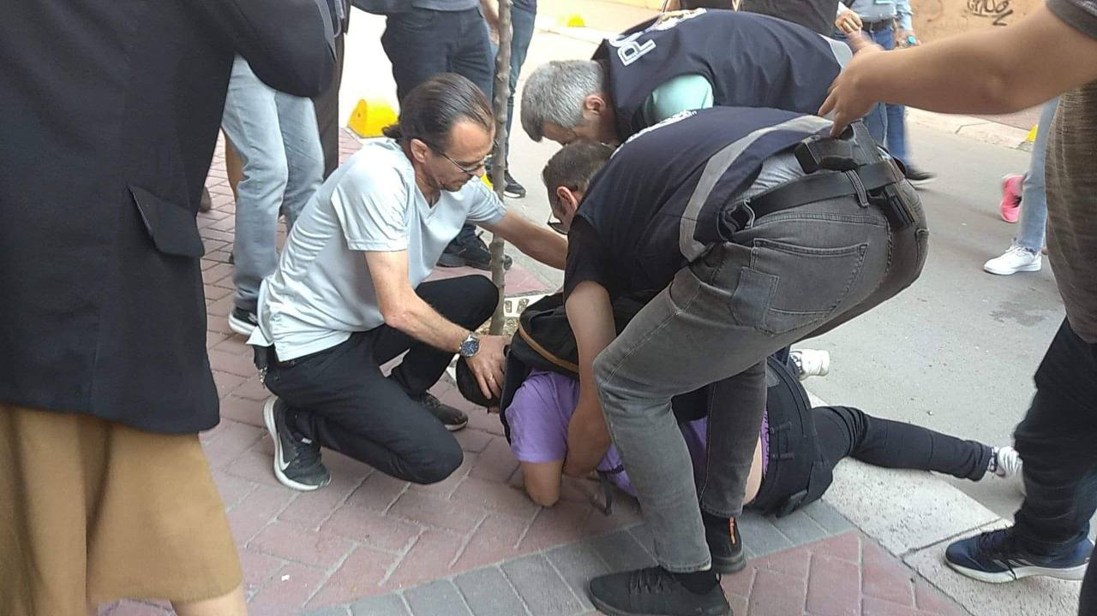
Pride Marches/Events vs. Hate Marches/Events
2022 Eskişehir Pride March
On 3 June 2022, LGBTİ+ took to the streets of Eskişehir to carry out the march planned as part of Pride Week. Before they could reach the starting point of the march, at least 19 LGBTİ+ were violently taken into police custody.
On 7 October 2022, the Eskişehir Chief Public Prosecutor’s Office indicted 8 out of 10 people who were taken into police custody with “defying the Law no. 2911 on Demonstrations and Assemblies.” The trial continues.

Slide 24
Pride Marches/Events vs. Hate Marches/Events
2022 Istanbul Pride March
On 20 June 2022, Beyoğlu and Kadıköy District Governorships imposed a week-long ban targeting the 30th Istanbul LGBTİ+ Week events “to preserve peace, security and well being and prevention of committing crimes within the borders of the district.”
The Beyoğlu District Governorship later defended this decision in a petition submitted to an Istanbul court after some civil society organizations filed a lawsuit against the decision as a way of thwarting the international conspiracy targeting Turkey.
On the day of the ban decision, the organizing committee of the 30th LGBTİ+ Week announced that they will go on with their organizations

Slide 25
Pride Marches/Events vs. Hate Marches/Events
2022 Istanbul Pride March
On 20 June 2022, a radical Islamist group named “the Defense of the Islamic Movement” put out a call for a press statement and “a watch” in front of the Taksim mosque on the day of the planned Pride March.
On 25 June 2022, the group announced that they will not be in Taksim.

Slide 26
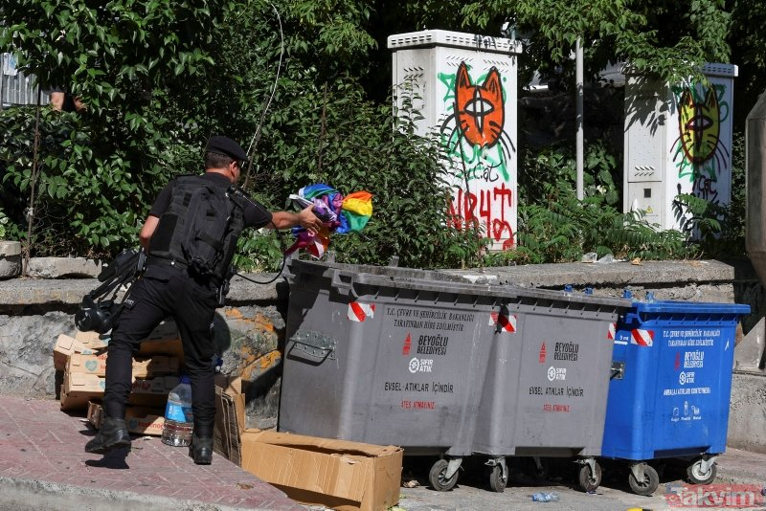
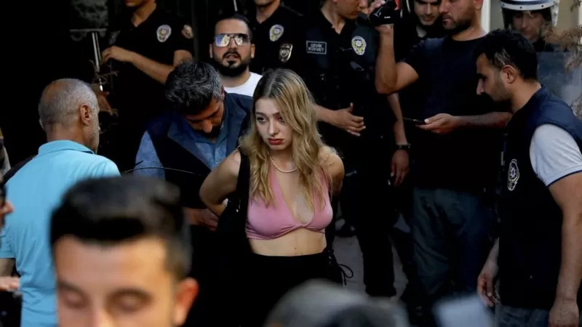
Pride Marches/Events vs. Hate Marches/Events
2022 Istanbul Pride March
Despite the ban decision, LGBTİ+ took to the streets on 26 June 2022 and were immediately and violently targeted by the police.

Slide 27
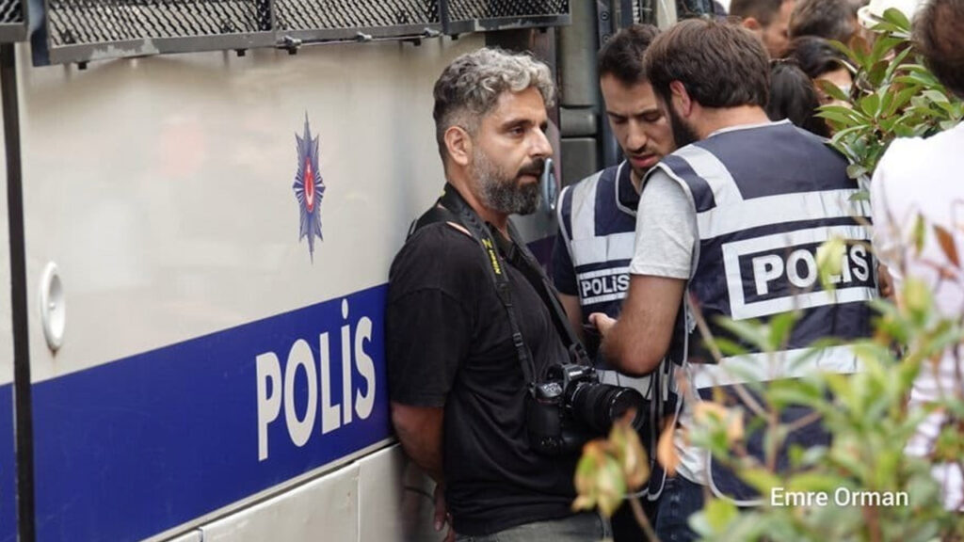
Pride Marches/Events vs. Hate Marches/Events
2022 Istanbul Pride March
Istanbul police took 373 people into custody including Agence France-Press reporter Bülent Kılıç.
The majority of them were kept in detention buses for hours in the heat of June and were not allowed to see their lawyers.
Before the lawyers could know the exact number of those taken into custody, the Defense of the Islamic Movement tweeted that they were informed by the police that “LGBT full of 28 buses have been taken into custody.”

Slide 28
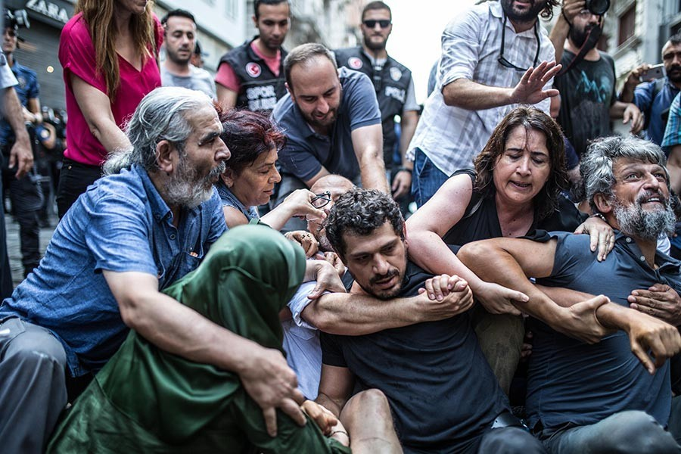
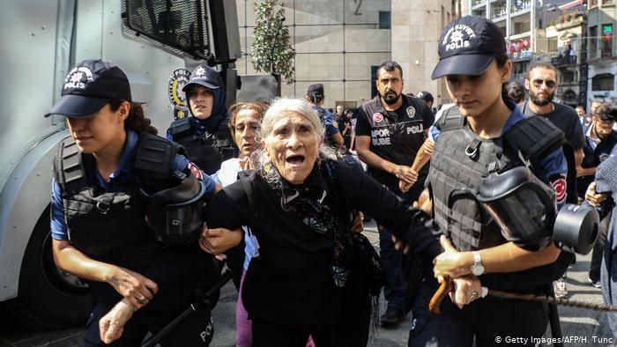
The Convenience of Article 22: Saturday Mothers v. the Defense of the Islamic Movement
On 25 August 2018, at the 700th week of gathering at the Galatasaray Square, Saturday Mothers/People were brutally attacked by the police.

Slide 29
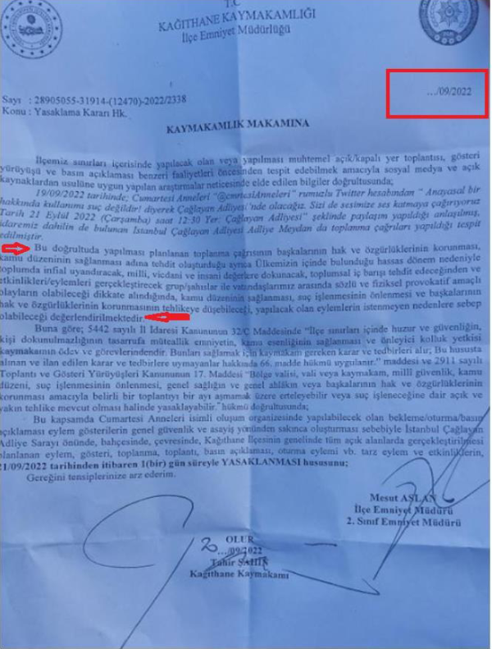
The Convenience of Article 22: Saturday Mothers v. the Defense of the Islamic Movement
Two months later, the Istanbul Chief Public Prosecutor’s Office indicted 46 people taken into custody that day with “defying the Law no. 2911” (Article 32/1 specifically and with ‘attending illegal demonstrations and marches, failure to disperse despite being warned’).
The seventh hearing of the trial which has been going on since 25 March 2021, was scheduled to be held on 21 September 2022. Before the hearing, Saturday Mothers/People wanted to hold a press statement in front of the courthouse.
Before the first word could be uttered, a police officer came forward and served an undated ban decision specifically targeting Saturday Mothers/People.

Slide 30
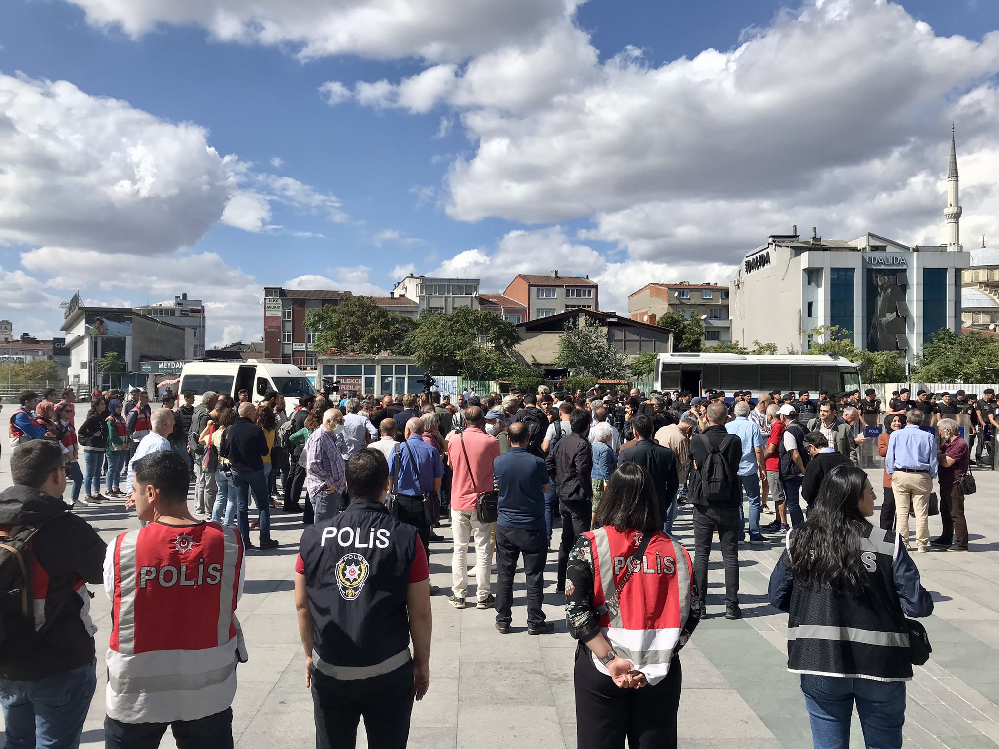
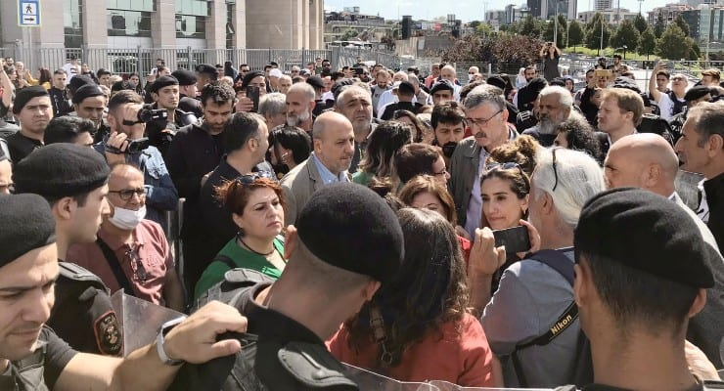
The Convenience of Article 22: Saturday Mothers v. the Defense of the Islamic Movement
Immediately after the ban decision was served, the police surrounded the Saturday Mothers/People and those who had come to support them.

Slide 31
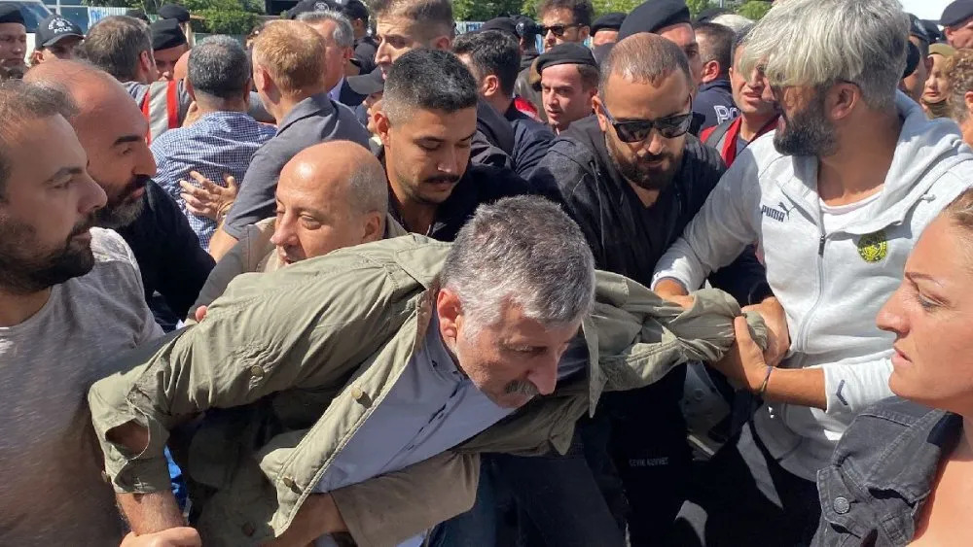
The Convenience of Article 22: Saturday Mothers v. the Defense of the Islamic Movement
After completely tightening the circle with their shields, the police attacked the group during which the Left Party Chair Alper Taş was literally dragged.

Slide 32
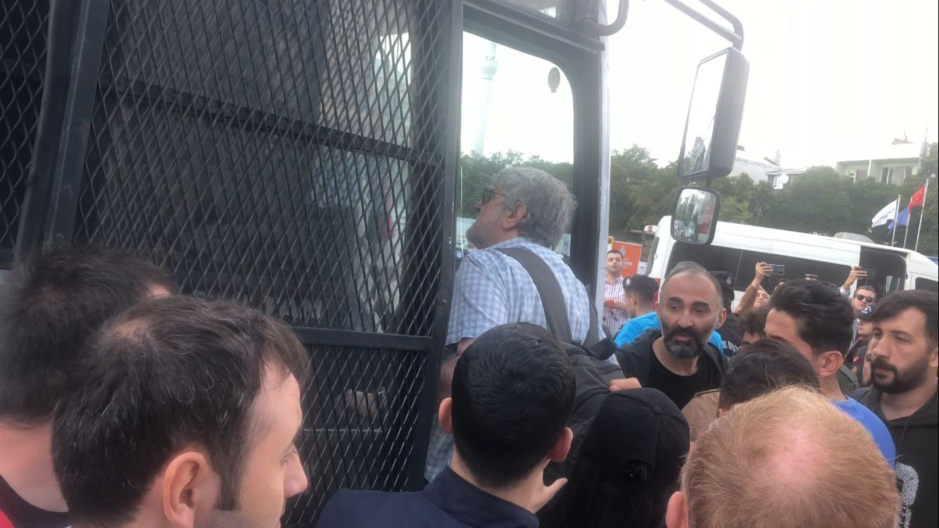
The Convenience of Article 22: Saturday Mothers v. the Defense of the Islamic Movement
On September 21st, the police took 14 people into custody. These included Saturday Mothers/People who stand trial in that case as well as their lawyers.
Those who were taken into custody were kept in police buses for hours and were transported from one police station to another while their hands were tightly cuffed with plastic handcuffs

Slide 33
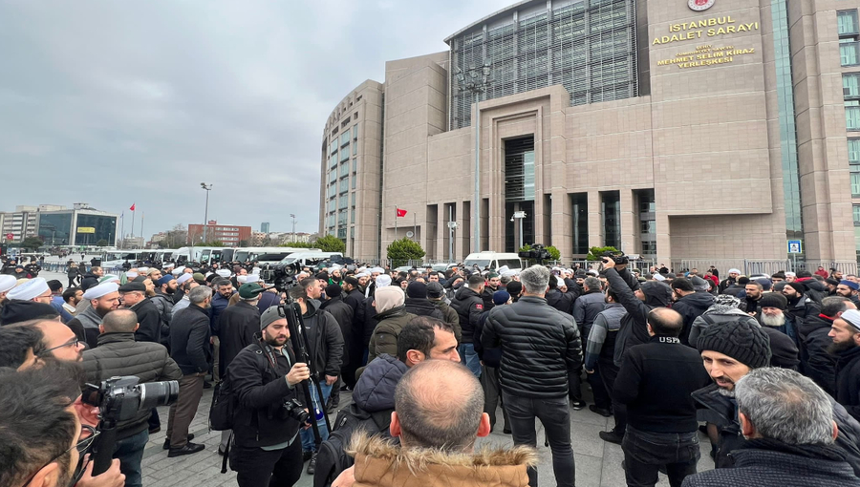
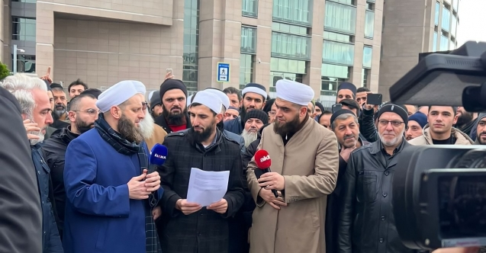
The Convenience of Article 22: Saturday Mothers v. the Defense of the Islamic Movement
On 21 December 2022, the radical islamist group called the Defense of the Islamic Movement received a radically different treatment from the police than that of the Saturday Mothers/People.

Slide 34
Conclusion
Turkish Government has not adopted necessary measures addressing the Court’s and the CM’s findings in the Oya Ataman Group cases or implemented strengthening of the freedom of assembly in general.
On the contrary, the situation regarding the exercise of the right to freedom of assembly has deteriorated in Türkiye. The right to freedom of assembly has been rendered ineffective and illusory.

Slide 35
Recommendations to CM on general measures
NGOs urge the CM to:
Continue the supervision on the execution of the Oya Ataman group of cases under the enhanced procedure and at more frequent intervals;
Urge Türkiye to revise its Action Plan and address in full the structural problems arising from the domestic legislative framework identified by the ECHR in the Oya Ataman group;
Amend Law No. 2911 to ensure that its provisions are fully in line with the principles set out in the case law of the ECtHR;
Amend Law No. 5442 to ensure that its provisions are fully in line with the principles set out in the case law of the ECtHR; in particular, amend Article 11(C) which grants broad powers to governors to ban both peaceful public assemblies and indoor human rights events;

Slide 36
Recommendations to CM on general measures
Review the 2016 Directive on the use of tear gas and other crowd control weapons to ensure that it complies in all respects with international standards in relation to the use of crowd control weapons;
Urge Türkiye to put in place an effective ex post facto review mechanism to assess the reasonableness and proportionality of any use of excessive force by law enforcement officials;
Call on Türkiye to stop the criminalization of the members of civil society who exercise their right to freedom of peaceful assembly.

