Slide 1
Stanev v Bulgaria CoE briefing
Aneta Genova - Network of Independent Experts
Simona Florescu – Validity Foundation
Strasbourg, 26 February 2023

Slide 2
Outline
The ECtHR Judgment
The monitoring of the implementation
Alternatives to institutions
The wish to remain in an institution
Conclusions and Recommendations

Slide 3
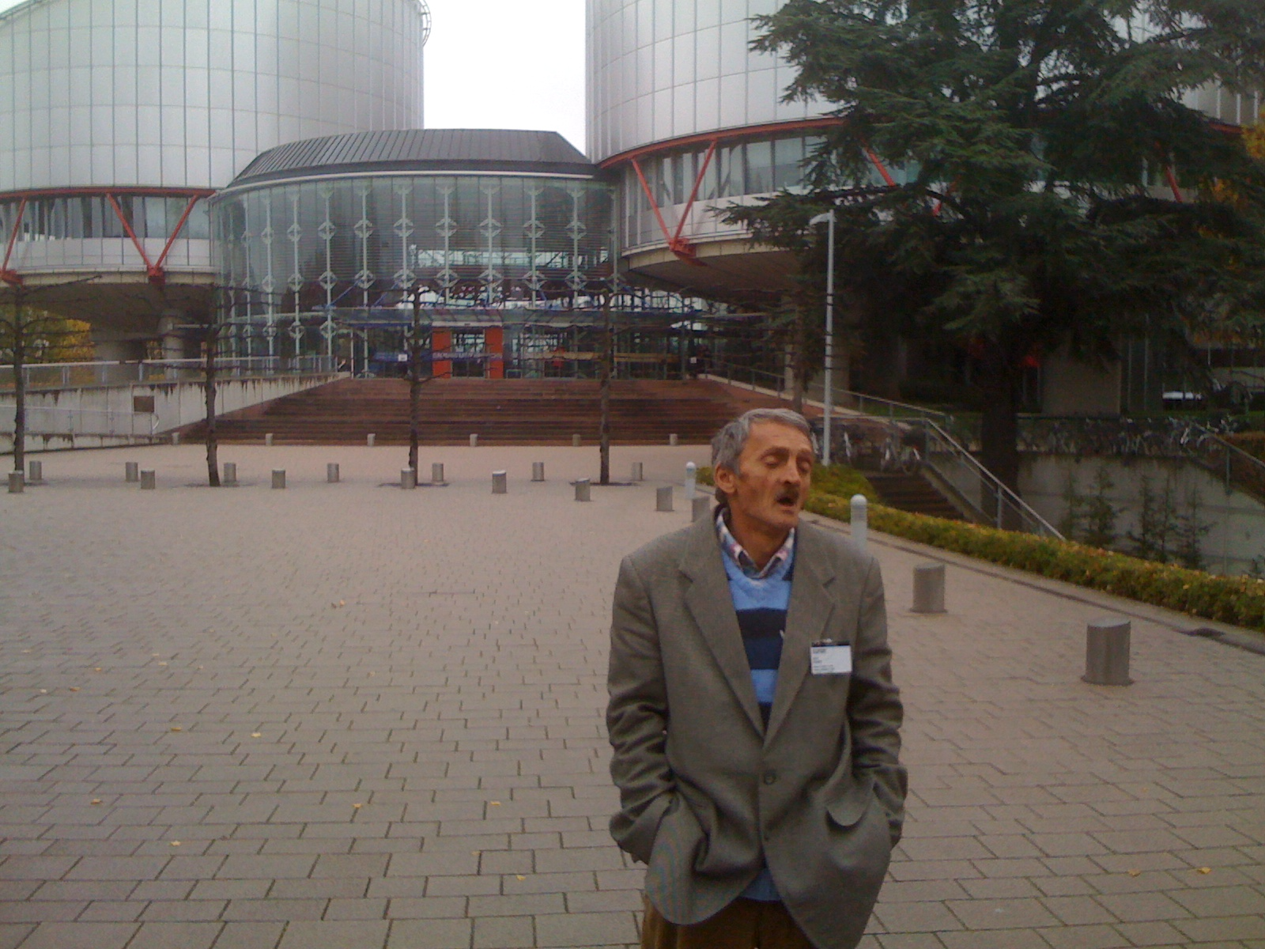
The case in Strasbourg The exchanges with the Government The scope of CM’s examination
The ECtHR Judgment

Slide 4
Concerns – alternatives to residential care
Terminology used: Small group homes / family-type
Features of an institution
Repetition of the same pattern
Example of a family type home:
https://novini.bg/bylgariya/obshtestvo/465247

Slide 5
Path forward – alternatives to residential care
The CM is empowered to monitor small group homes (relevant for both Article 3 and Article 5)
Under the Stanev judgment the state should provide for viable alternatives to residential care

Slide 6
The wishes of persons
Aneta

Slide 7
The wishes of persons
Aneta

Slide 8
The wishes of persons
Aneta

Slide 9
Conclusions
The implementation of the Stanev judgment requires and array of legal and policy measures;
The existance of viable community based services cannot be dissociated from the implementation of this judgment

Slide 10
Recommendations
It is imperative that the Committee continues to monitor the implementation of the judgment;
Strategies to ensure that persons with disabilities in family type homes have a path to live in the community; they have access to a complaint procedure and review of their placement;
Government should provide data on the number of persons with disabilities having left residential care to live in the community;

Slide 11
Recommendations
4. Procedural accomodations available to ensure that persons with disabilities participate in court proceedings;
5. Procedural accomodations and informations provided before and at signing the contracts for placement in family type homes.

Slide 12
Thank you Simona Florescu Simona@validity.ngo Aneta Mircheva aneta.mircheva@gmail.com

