Slide 1
Ilias and Ahmed v. Hungary
Contribution by the Hungarian Helsinki Committee
15 September, 2023

Slide 2
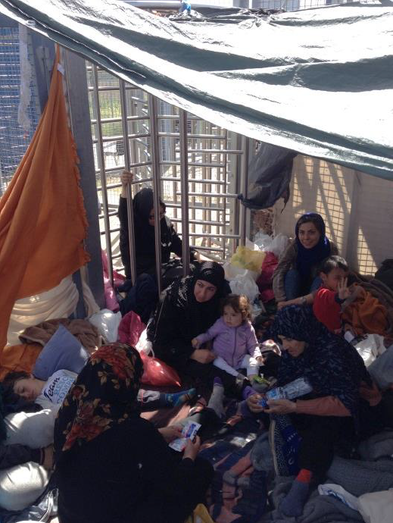
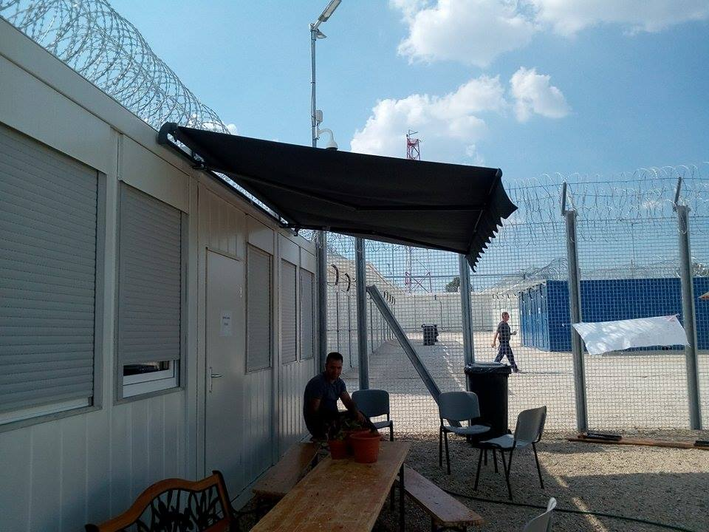
Ilias and Ahmed v. Hungary
Transit Zone in Röszke, Hungary (April 2016)
Source: HHC

Slide 3
Ilias and Ahmed v. Hungary
Ilias and Ahmed v. Hungary – app. 47287/15
GC judgment, 21.11.2019.
Facts:
In 2015, two Bangladeshi nationals were detained in transit zone for 23 days at the Hungarian-Serbian border after filing an application for asylum and then were forced to return to Serbia without the in-merit examination of their asylum claims. (inadmissible decision – Serbia being a safe third country –)
GC judgment:
There was an insufficient basis for the Government’s decision to establish a general presumption concerning Serbia as a safe third country.
The expulsion decisions disregarded the authoritative findings of the UNHCR as to a real risk of denial of access to an effective asylum procedure in Serbia and summary removal from Serbia to North Macedonia and then to Greece.
The Hungarian authorities exacerbated the risks facing the applicants by inducing them to enter Serbia illegally instead of arranging for an orderly return.

Slide 4
Last exam of the Committee of Ministers
Ilias and Ahmed v. Hungary – app. 47287/15
Shazad v. Hungary – app. 12625/17
The CM:
strongly urged the authorities to carry out a reassessment of the legislative presumption of “safe third country” in respect of Serbia;
called on the authorities to intensify their efforts in reforming the asylum system in order to afford effective access to means of legal entry;
strongly reiterated their urgent call on the authorities to terminate the practice of removing asylum-seekers to Serbia;
called on the authorities to envisage the introduction of an effective remedy for persons alleging that their expulsion procedure was “collective”.

Slide 5
Legislative changes
Positive changes:
The “safe transit country” inadmissibility ground according to Section 51(2)(f) of the Asylum Act (found against EU law by the CJEU) was abolished as of 1 January 2023.
Remaining gaps:
There has been no reassessment of the legislative presumption of Serbia being a „safe third country” carried out by the Hungarian authorities.
Section XIV (4) of the Fundamental Law, which provided the constitutional foundation for the 'safe transit country' concept remains to be in force.
Sections 5 (1a) and (1b) of Act LXXXIX of 2007 on the State Border legalizing summary removals to Serbia remain to be in force.
Section 5 (1b) of Act LXXXIX of 2007 on the State Border extending the above legalization to the whole territory of the country under the state of crisis due to mass migration remains to be in force.

Slide 6
Embassy system
The Government’s communication, 26.6.2023:
„The legislative presumption of “safe third country” for Serbia has not been applied by the asylum authority and the national courts since the introduction of the transitional asylum procedure as of 26 May 2020 (“Embassy procedure”)”
C-823/21, Commission v. Hungary, 22.6.2023:
In the respective infringement procedure the CJEU ruled that:
By making the possibility, for certain third-country nationals or stateless persons present in its territory or at its borders of making an application for international protection subject to the prior submission of a declaration of intent at a Hungarian embassy situated in a third country and to the grant of a travel document enabling them to enter Hungarian territory, Hungary has failed to fulfil its obligations under the Asylum procedures directive.

Slide 7
Embassy system
Year | Statements of intent received by NDGAP from the embassy | Positive „recommendations”
2020 | 26 | 4
2021 | 52 | 8
2022 | 16 | 4
2023 (Jan-Jun) | 1 | 0
Year | Registered first-time asylum applications | Granted protection statuses
2020 | 92 | 126 (83 refugee, 43 subsidiary protection)
2021 | 38 | 38 (21 refugee, 17 subsidiary protection)
2022 | 44 | 30 (10 refugees, 20 subsidiary protection)
2023 (Jan-Jun) | 19 | 17 (6 refugees, 11 subsidiary protection)

Slide 8
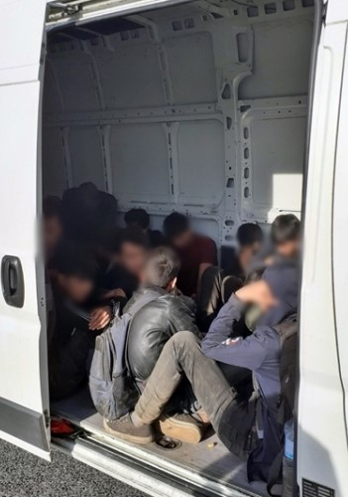
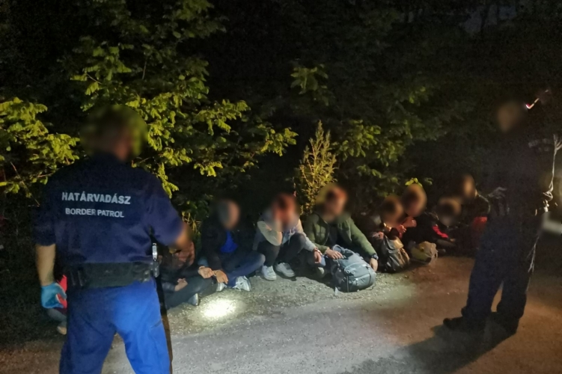
Summary removals to Serbia
Police apprehension in Győr (2020) and Vámospércs (2023), Hungary.
Source: police.hu

Slide 9
Summary removals to Serbia
Legislation:
Section 5(1)(b) of the Act LXXXIX of 2007 on State Borders that regularized collective expulsions to Serbia remain to be in force.
Refusal to implement judgments:
R.N. v. Hungary 4.4.2023.
H.K. v. Hungary, 22.9.2022.
Shazad v. Hungary, 8.10.2021.
C-808/18, Commission v. Hungary,17.12.2020.

Slide 10
Summary removals to Serbia

Slide 11
The war in Ukraine
Refusal of entry:
Late January 2023, the practice at the Hungarian/Ukrainian border has changed. According to the new rules only those are granted entry:
who have the necessary and valid travel documents (e.g. visa, passport);
who are not under the effect of an entry ban;
those third-country nationals who did not enter Ukraine after 24 February 2022.
As a result, third-country nationals (non Ukrainians) who have returned to Ukraine after the war are refused entry to Hungary. The non-refoulement examination bares serious shortcomings.

Slide 12
Conclusion and recommendations
The HHC respectfully recommends the CM to continue examining the execution of the judgment.
Recommendations to the Government of Hungary:
Conduct a new adequate assessment of all existing sources on the situation of asylum seekers in Serbia.
Amend Section 51(2)(e) and Section 51/A of the Asylum Act to ensure that the “safe third country” concept is applied and expulsion is ordered only if the third country takes back the asylum seeker in an orderly manner.
Repeal the legislation legalizing summary removals and until it is done refrain from the unlawful practice on continuing these removals.
Take measures to ensure effective access to territory and procedure for those seeking protection at the borders and on the territory of Hungary.
Refrain from unlawful refusals at the Hungarian-Ukrainian border.

Slide 13
Thank you!
Balázs Gaál balazs.gaal@helsinki.hu

