Slide 1
Rule 9 (2) submission to the Committee of Ministers of the Council of Europe with regard to the execution of judgments on the Identoba and Others group of cases
Georgian Young Lawyers' Association (GYLA)
Strasbourg, France, 2021

Slide 2
This group unites the following cases:
Identoba and Others v. Georgia (№ 73235/12, 12/05/2015);
97 Members of the Gldani Congregation of Jehovah’s Witnesses and 4 Others v. Georgia (№ 71156/01, 03/05/2007);
Begheluri and Others v. Georgia (№ 28490/02, 07/10/2014);
Tsartsidze and Others v. Georgia (№ 18766/04, 17/01/2017);
Aghdgomelashvili and Others v. Georgia (№ 7224/11, 08/10/2020).

Slide 3
Outline
The matters arising in relation to the general measures;
The key concerns and challenges related to the human rights condition of LGBT+ and Jehovah’s witnesses;
The recommendations and a number of steps that are required to ensure the full and effective execution of these judgments.

Slide 4
On 1383rd meeting, 29 September – 1 October 2020 (DH)
The Deputies noted with concern the Public Defender’s 2019 special report on discrimination and NGO communications indicating that discrimination on grounds of sexual orientation and gender identity remains a serious challenge in Georgia, including the realisation of freedom of expression and assembly by LGBTI persons and Jehovah Witnesses, while the identification of bias in the context of investigations remains a major challenge

Slide 5
The Key Concern N1
LGBT+ community and Jehovah’s witnesses still remain one of the most vulnerable groups in the society;
LGBT+ community still has difficulties with full enjoyment of their right to assembly, education, labor and availability with healthcare and social services;
Discrimination based on religion or gender identity is encouraged by the public officials, while they shall take a crucial part in rising social awareness to the fight against homophobia and religious intolerance.

Slide 6
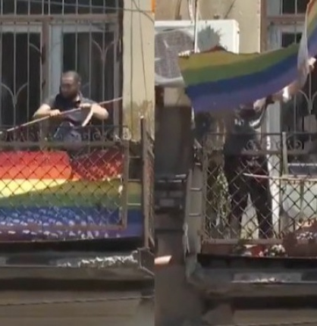
On 5th July 2021, "March of Dignity" was threatened by violent, homophobic, ultra-right groups, who resort to violent actions. Ministry of Internal Affairs failed to ensure the effective management of the process and the mobilization of an adequate number of police forces, which further contributed to the aggravation of the process.

Slide 7
Key Concern N2
The Government of Georgia is not complying with the decision of the Committee of Ministers, by which the CM on 1383rd meeting, 29 September – 1 October 2020 (DH), the Deputies reiterated their call on the authorities to establish a specialised investigative unit within the police in order to carry out effective investigations into hate crime.

Slide 8
Key Concern N3
As of today, the Code of Administrative Offences does not envisage the possibility of establishing discriminatory motive, as the aggravating factor for administrative liability.
This means that an illegal act committed against LGBT+ community and/or Jehovah’s Witnesses, which does not attain the criminal liability threshold, but according to the assessment of the investigative authorities, is qualified under the particular Article’s simple composition of the CAO, it is impossible to establish discriminatory motive even in theory.

Slide 9
In order that the Identoba and Others Group cases are effectively and adequately implemented, GYLA considers that the Government:
should create specialized investigative unit within the Ministry of Internal Affairs that would be capable of investigating the hate crimes;
should amend the Code of Administrative Offences and define the discriminatory motive, as the aggravating factor of the liability;
should undertake social awareness-rising campaigns concerning the prohibition of discrimination and hate crimes;
should undertake relevant activities and measures in order to enhance the trust between the law enforcement agencies and the LGBT+ community and religious minorities.

Slide 10
Thank you for the attention!
Questions?

